Slide 1
Chapter 28
Art Between the Wars

Slide 2
Learning Objectives
Discuss why World War I was a determining influence on the art and architecture made between the wars.
Assess why certain Dada artists were so appealing to the Surrealists and understand the forces that brought about Surrealism.
Describe how a utopian vision is embraced in much of the European art, architecture, and design of the period and the variety of ways it was expressed in Russia, The Netherlands, Germany, and France.
Explain how the post-World War I role of the United States as technological and financial world leader is reflected in the nation’s art and the way in which this work differs from the art produced in Europe.
Discuss how African-American and Mexican artists transformed the image of non-Europeans in Western art, laying a foundation for the multicultural art in the second half of the century.

Slide 3
Art Between the Wars in Europe
Artists responded to the destruction of World War I by criticizing the Europeans.
Other artists focused on rebuilding from the loss of a generation of young men.
Russian artist Vladimir Tatlin combined avant-garde sculpture with a fully utilitarian building to spread the spirit of communism.

Slide 4
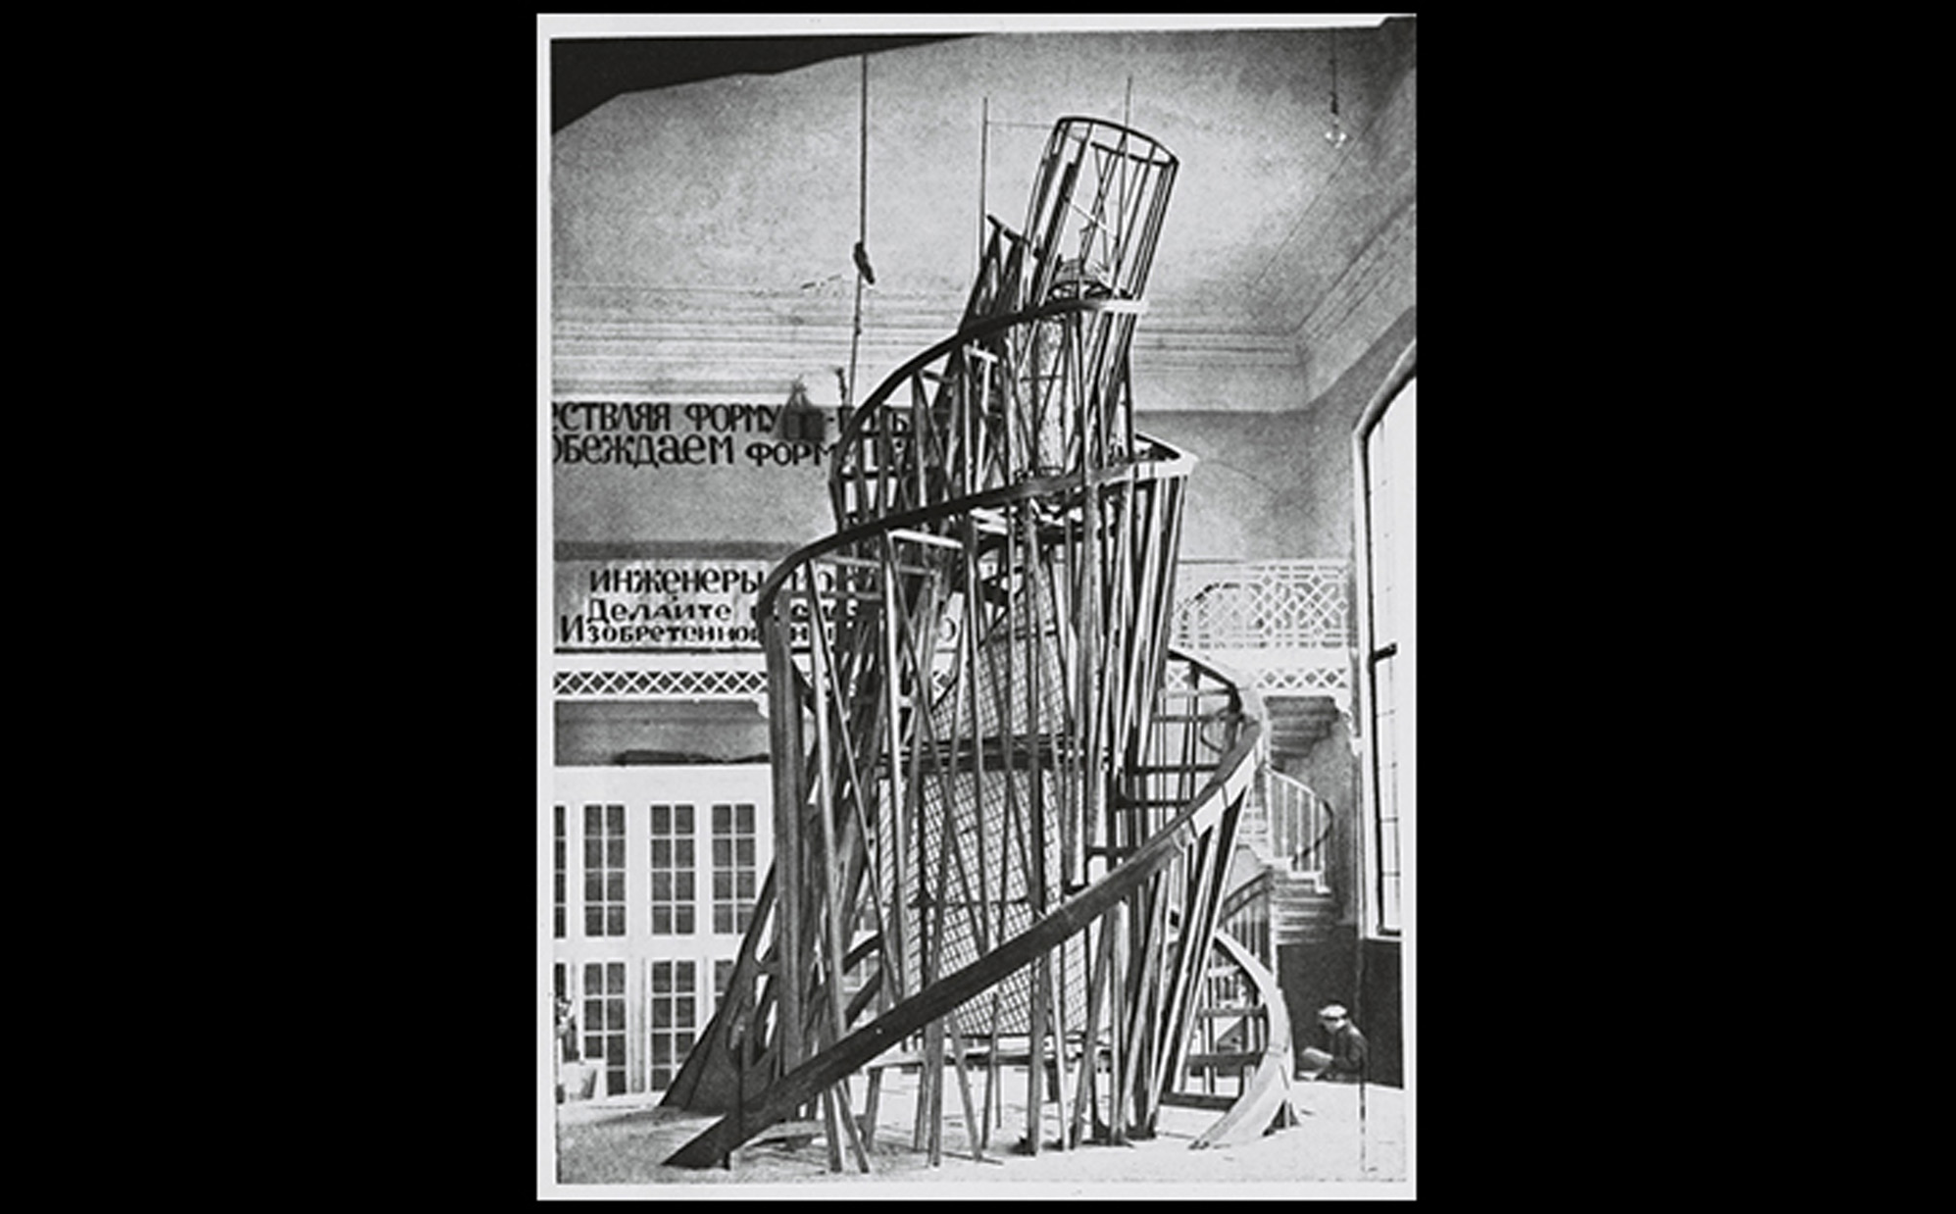
Vladimir Tatlin MODEL FOR THE MONUMENT TO THE THIRD INTERNATIONAL 1919–1920. Wood, iron, and glass. Destroyed. © Vladimir Tatlin.
Notes:
Vladimir Tatlin MODEL FOR THE MONUMENT TO THE THIRD INTERNATIONAL 1919–1920. Wood, iron, and glass. Destroyed. © Vladimir Tatlin.

Slide 5
Utilitarian Art Forms in Russia (1 of 3)
After socialist Bolsheviks turned to civil war during the 1917 Russian Revolution.
Constructivism
Alexander Rodchenko helped establish a post-revolutionary group of artists who worked together for the good of the state.

Slide 6
Utilitarian Art Forms in Russia (2 of 3)
Constructivism
Worker's Club was a model designed for ease of use. It made use of the Soviet wood industry
Engineer El Lissitzky used Malevich's formal vocabulary to create "Prouns," some of which were early examples of installation art.

Slide 7
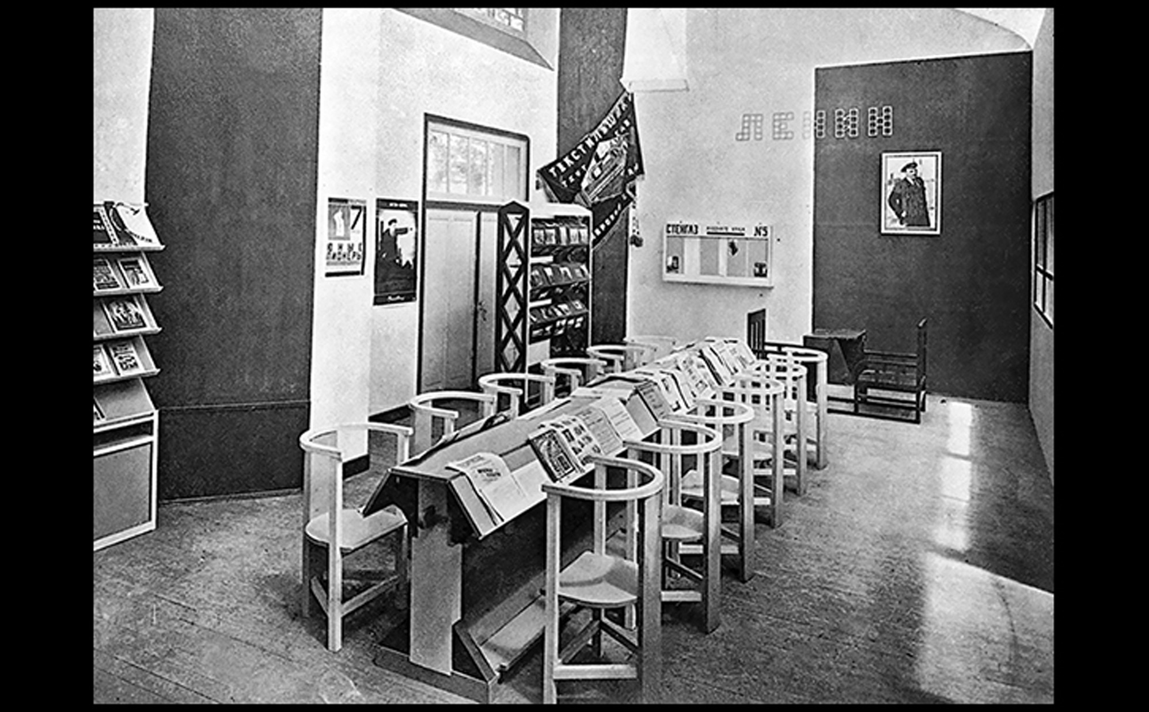
Aleksandr Rodchenko WORKERS' CLUB Exhibited at the International Exposition of Modern Decorative and Industrial Arts, Paris. 1925. Art © Estate of Aleksandr Rodchenko/RAO, Moscow/VAGA, New York.
Notes:
Aleksandr Rodchenko WORKERS' CLUB Exhibited at the International Exposition of Modern Decorative and Industrial Arts, Paris. 1925. Art © Estate of Aleksandr Rodchenko/RAO, Moscow/VAGA, New York.

Slide 8
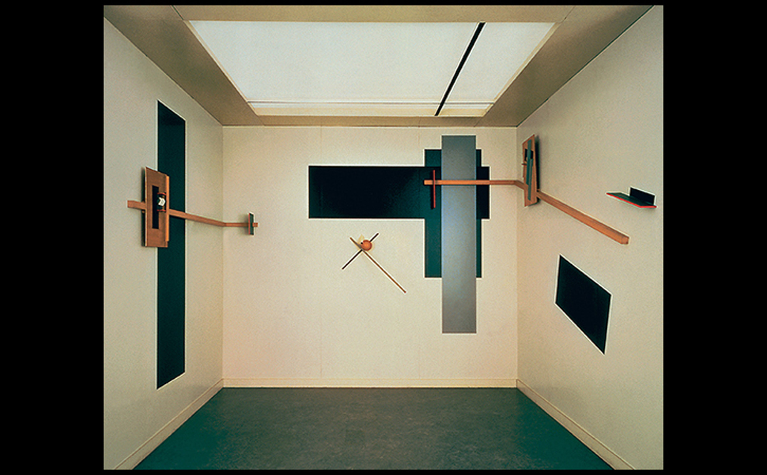
El Lissitzky PROUN SPACE Created for the Great Berlin Art Exhibition. 1923, reconstruction 1971. Collection Van Abbemuseum, Eindhoven, The Netherlands. Photo: Peter Cox, Eindhoven, The Netherlands.
Notes:
El Lissitzky PROUN SPACE Created for the Great Berlin Art Exhibition. 1923, reconstruction 1971. Collection Van Abbemuseum, Eindhoven, The Netherlands. Photo: Peter Cox, Eindhoven, The Netherlands.

Slide 9
Utilitarian Art Forms in Russia (3 of 3)
Socialist Realism
Art in the Socialist Realism style was made to be more universally accessible and politically useful.
It was supported by the Association of Artists of Revolutionary Russia, founded in 1922.
Worker and Collective Farm Woman shows two figures as equal partners holding up a hammer and sickle.

Slide 10
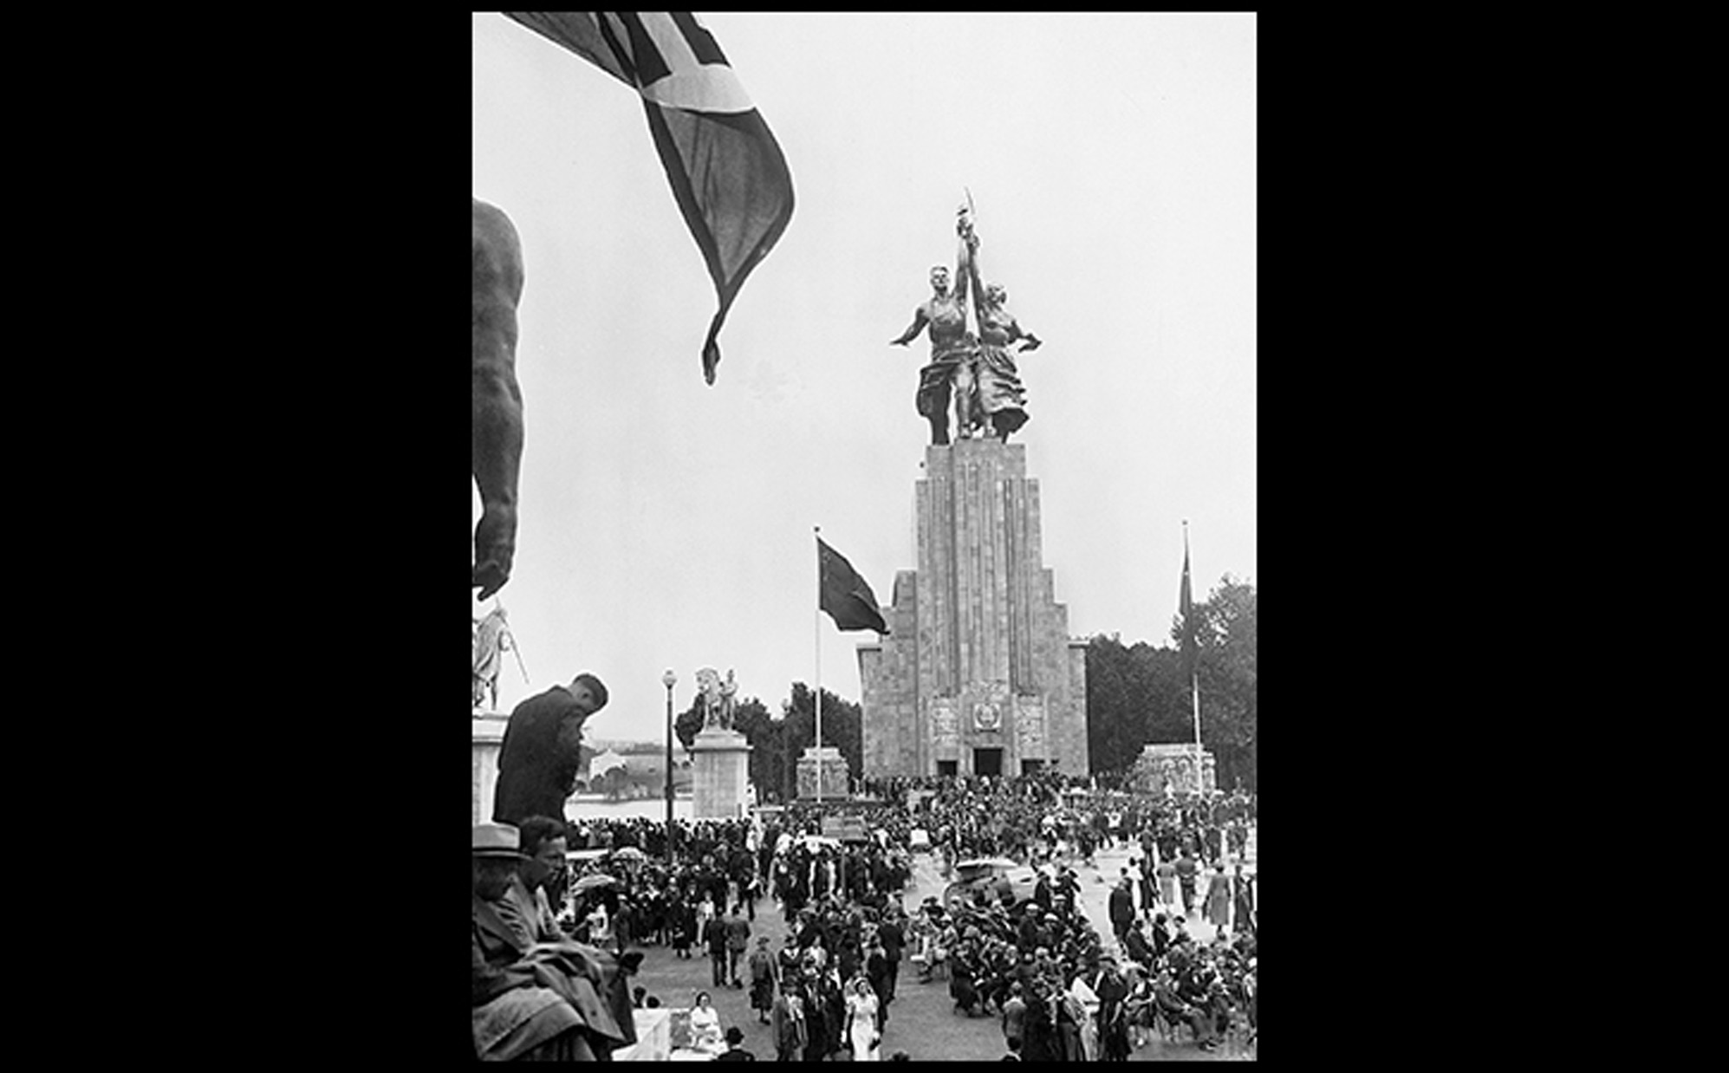
Vera Mukhina WORKER AND COLLECTIVE FARM WOMAN Sculpture for the Soviet Pavilion, Paris Universal Exposition. 1937. Stainless steel, height approx. 78' (23.8 m). Art © Estate of Vera Mukhina/RAO, Moscow/VAGA, New York.
Notes:
Vera Mukhina WORKER AND COLLECTIVE FARM WOMAN Sculpture for the Soviet Pavilion, Paris Universal Exposition. 1937. Stainless steel, height approx. 78' (23.8 m). Art © Estate of Vera Mukhina/RAO, Moscow/VAGA, New York.

Slide 11
De Stijl in the Netherlands (1 of 2)
Piet Mondrian led the De Stijl movement, which addressed two kinds of beauty: sensual and rational.
Composition with Yellow, Red, and Blue shows his restriction of formal vocabulary to the primary colors and neutrals.
He called it "dynamic equilibrium," and it introduced a universal style with applications beyond art.

Slide 12

Piet Mondrian COMPOSITION WITH YELLOW, RED, AND BLUE 1927. Oil on canvas, 14-7/8" × 13-3/4" (37.8 × 34.9 cm). The Menil Collection, Houston. © 2012 Mondrian/Holtzman Trust c/o HCR International USA.
Notes:
Piet Mondrian COMPOSITION WITH YELLOW, RED, AND BLUE 1927. Oil on canvas, 14-7/8" × 13-3/4" (37.8 × 34.9 cm). The Menil Collection, Houston. © 2012 Mondrian/Holtzman Trust c/o HCR International USA.

Slide 13
De Stijl in the Netherlands (2 of 2)
Architect and designer Gerrit Rietveld created the Schröder House in Utrect in the Modern movement known as the International Style.
Dynamic equilibrium was applied to the entire house.
The famous "Red-Blue" Chair in the bedroom is shown in a partitioned bedroom.

Slide 14
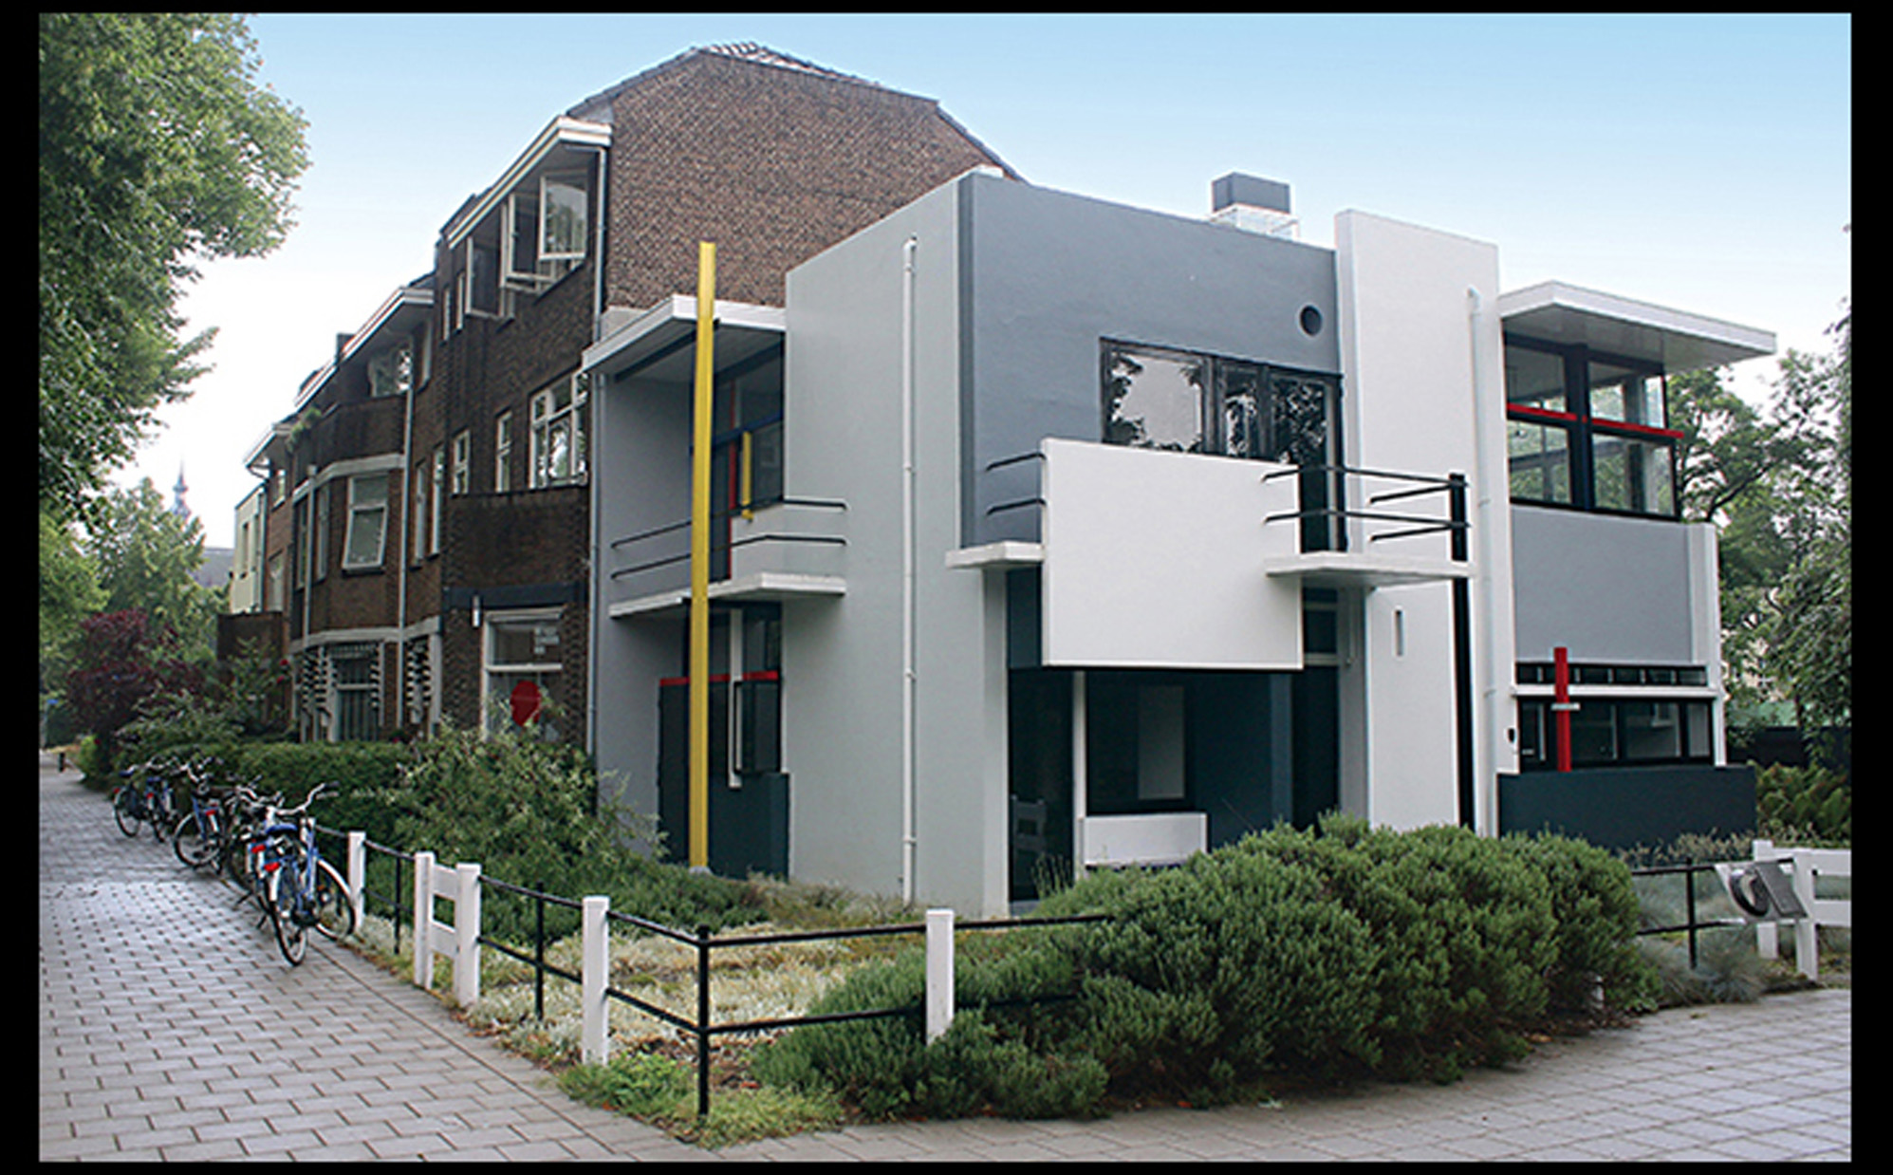
Gerrit Rietveld SCHRÖDER HOUSE, UTRECHT The Netherlands. 1925. © Ger Bosma/Alamy Stock Photo.
Notes:
Gerrit Rietveld SCHRÖDER HOUSE, UTRECHT The Netherlands. 1925. © Ger Bosma/Alamy Stock Photo.

Slide 15
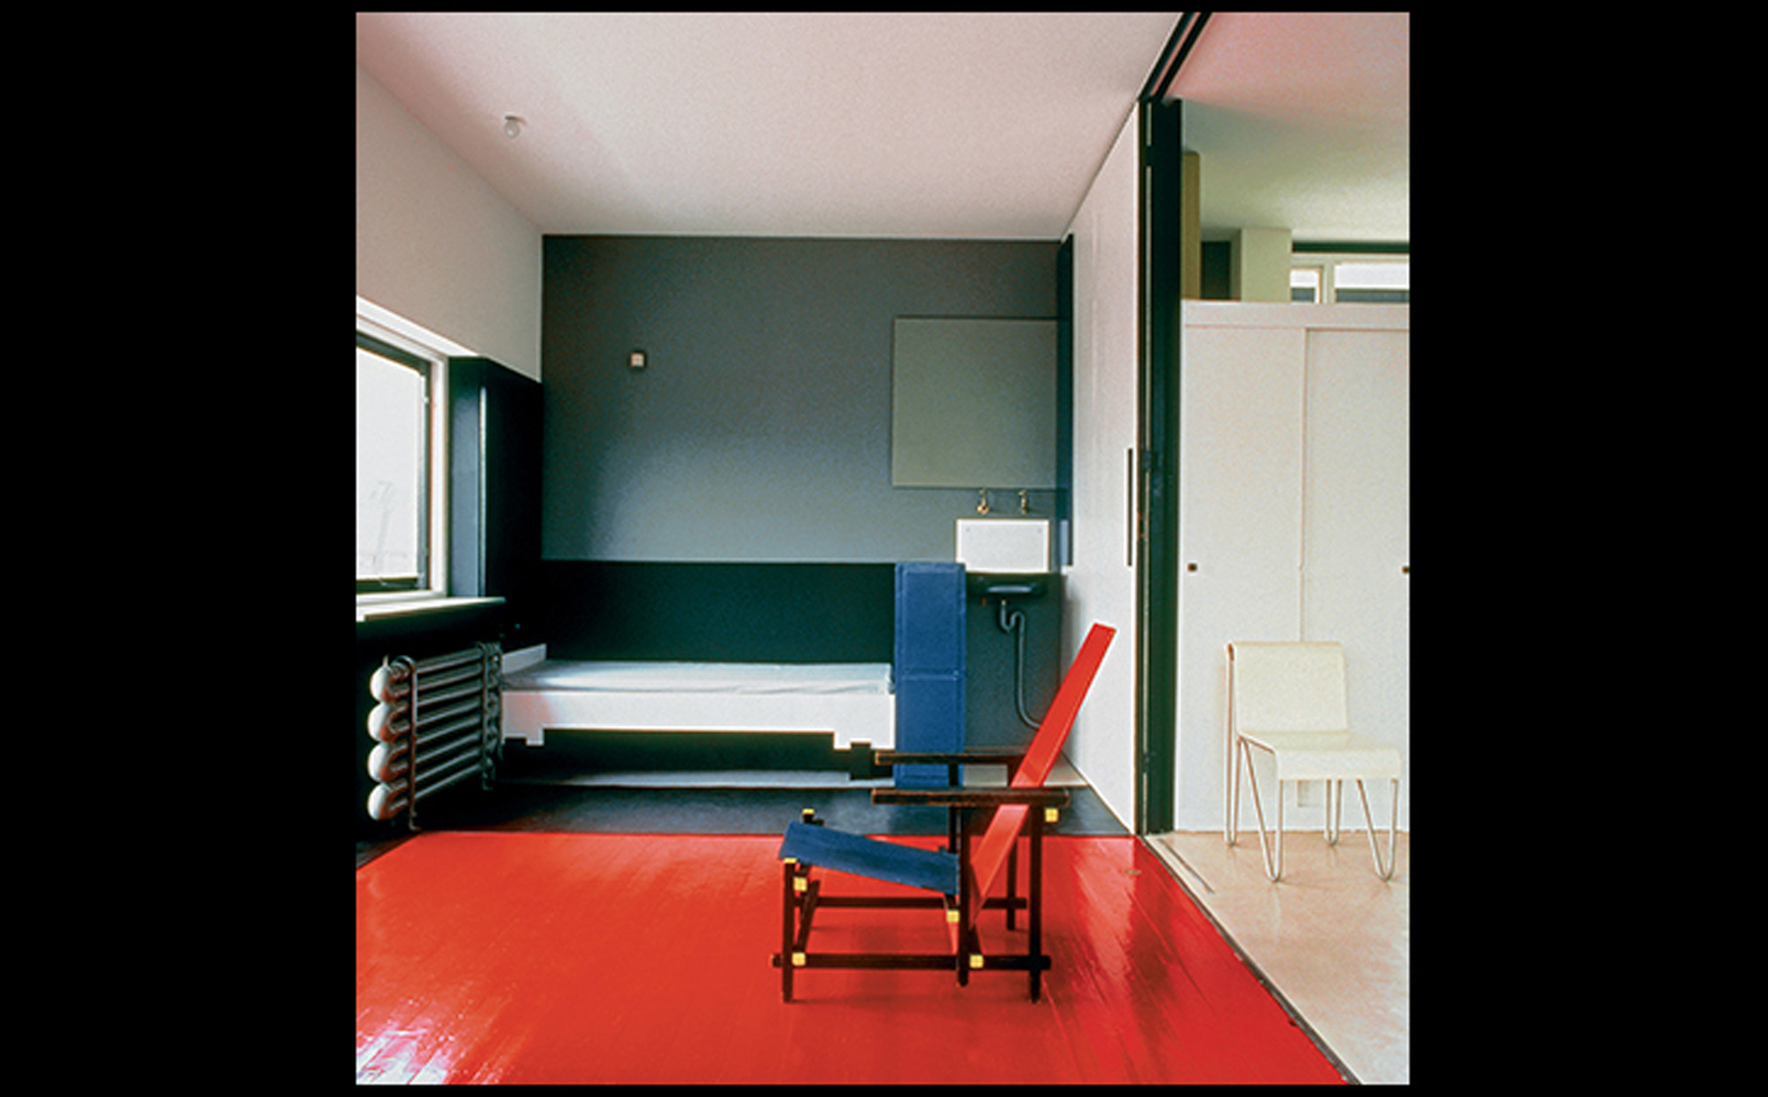
Gerrit Rietveld INTERIOR, SCHRÖDER HOUSE, WITH "RED-BLUE" CHAIR 1925. Photo: Jannes Linders. © 2016 Artists Rights Society (ARS), New York/c/o Pictoright Amsterdam.
Notes:
Gerrit Rietveld INTERIOR, SCHRÖDER HOUSE, WITH "RED-BLUE" CHAIR 1925. Photo: Jannes Linders. © 2016 Artists Rights Society (ARS), New York/c/o Pictoright Amsterdam.

Slide 16
The Bauhaus in Germany (1 of 5)
Gropius designed the building when the Bauhaus moved to the city of Dessau.
Technology advances meant no need for walls as structural supports, so he replaced them with glass panels on some sides.
Ludwig Mies van der Rohe directed the Bauhaus from 1930 on.
Adolf Hitler forced its closure in 1933.

Slide 17
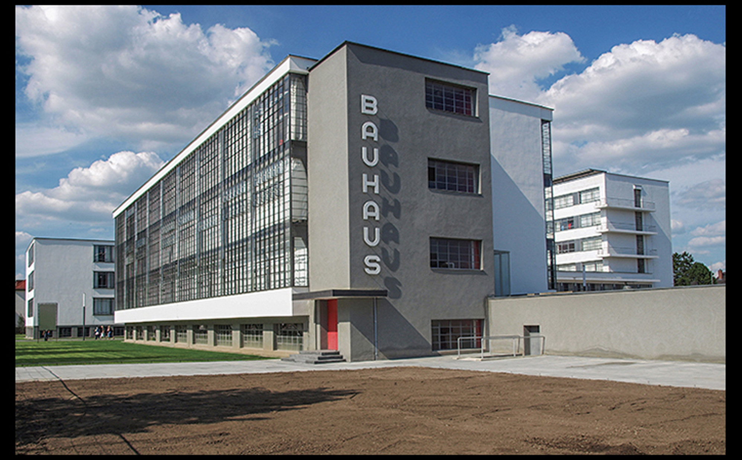
Walter Gropius BAUHAUS BUILDING, DESSAU Anhalt, Germany. 1925–1926. View from northwest. © 2016 Artists Rights Society (ARS), New York/VG Bild-Kunst, Bonn. © stockeurope/Alamy Stock Photo.
Notes:
Walter Gropius BAUHAUS BUILDING, DESSAU Anhalt, Germany. 1925–1926. View from northwest. © 2016 Artists Rights Society (ARS), New York/VG Bild-Kunst, Bonn. © stockeurope/Alamy Stock Photo.

Slide 18
The Bauhaus in Germany (2 of 5)
The Bauhaus was the brainchild of Walter Gropius and at first, it did not have a formal training program.
Learning was rooted in doing.
The workshops were reoriented under Moholy-Nagy to create sleek, functional designs suitable for mass production.
An example is Marianne Brandt's Tea and Coffee Service.

Slide 19
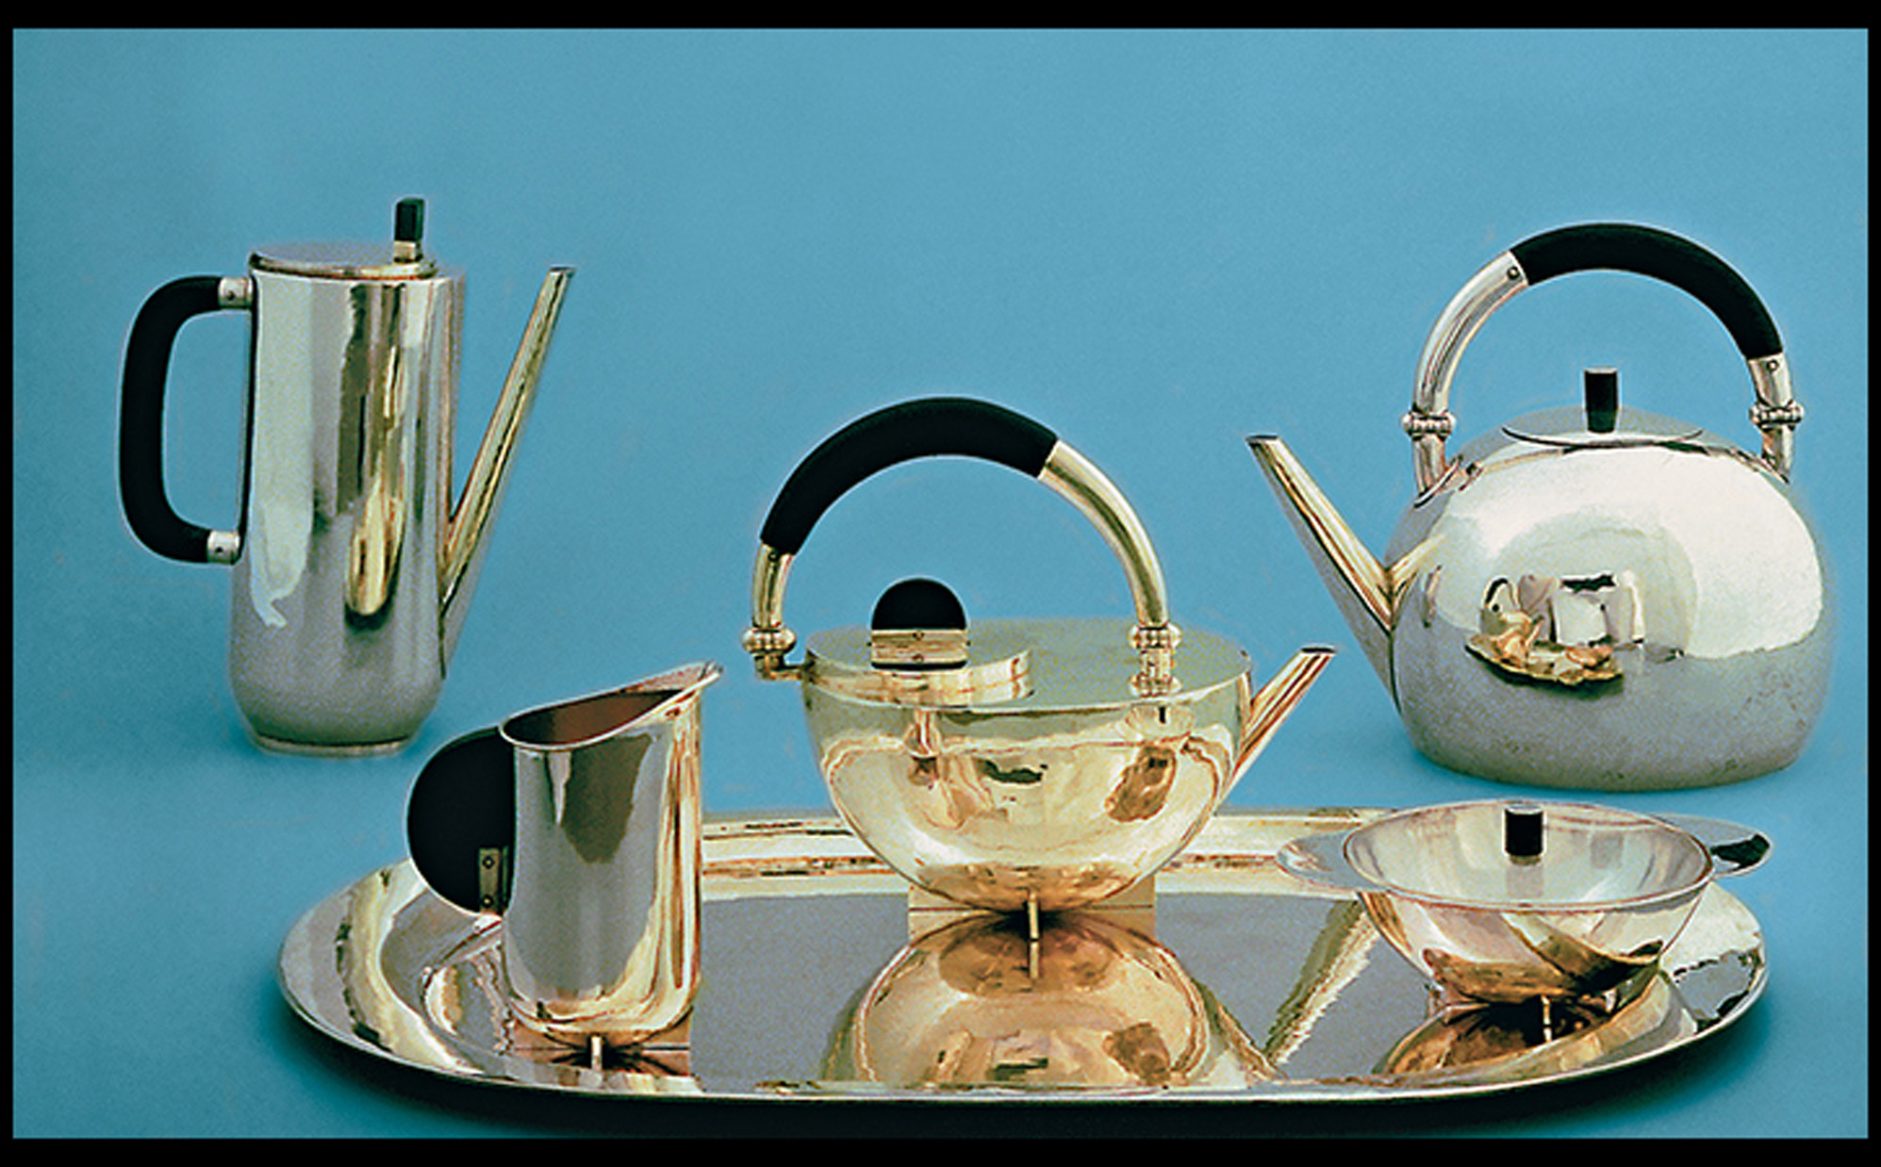
Marianne Brandt COFFEE AND TEA SERVICE 1924. Silver and ebony, with Plexiglas cover for sugar bowl. Tray, 13" × 20-1/4" (33 × 51.5 cm). Bauhaus Archiv, Berlin. © 2016 Artists Rights Society (ARS), New York/VG Bild-Kunst, Bonn.
Notes:
Marianne Brandt COFFEE AND TEA SERVICE 1924. Silver and ebony, with Plexiglas cover for sugar bowl. Tray, 13" × 20-1/4" (33 × 51.5 cm). Bauhaus Archiv, Berlin. © 2016 Artists Rights Society (ARS), New York/VG Bild-Kunst, Bonn.

Slide 20
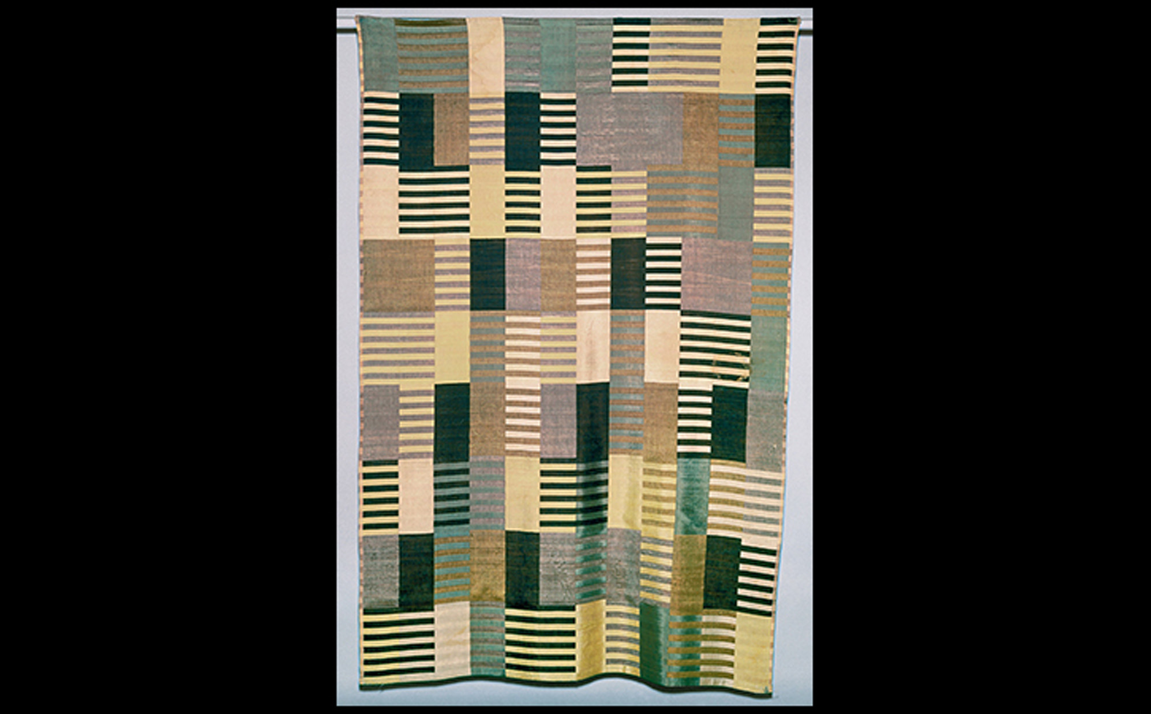
Anni Albers WALL HANGING 1926. Silk, three-ply weave, 5'11-5/16" × 3'11-5/8" (1.83 × 1.22 m). Harvard Art Museums/Busch-Reisinger Museum, Association Fund. © 2016 The Josef and Anni Albers Foundation/Artists Rights Society (ARS), New York. Bridgeman Images.
Notes:
Anni Albers WALL HANGING 1926. Silk, three-ply weave, 5'11-5/16" × 3'11-5/8" (1.83 × 1.22 m). Harvard Art Museums/Busch-Reisinger Museum, Association Fund. © 2016 The Josef and Anni Albers Foundation/Artists Rights Society (ARS), New York. Bridgeman Images.

Slide 21
The Bauhaus in Germany (3 of 5)
The International Style
The "International Style," developed beginning in 1927, was focused on three principles:
The conception of architecture as volume rather than mass
Regularity rather than symmetry as the chief means of ordering design
Arbitrary applied decoration

Slide 22
The Bauhaus in Germany (4 of 5)
Suppression of the Avant-Garde in Nazi Germany
A principal target of suppression was the Bauhaus school of art and design.
After Adolf Hitler came to power, the Bauhaus was forced to close for good.
Nazis attacked Modernist painters, whose intense depictions of German soldiers were considered unpatriotic.

Slide 23
The Bauhaus in Germany (5 of 5)
Suppression of the Avant-Garde in Nazi Germany
Nazi leadership organized the "Degenerate Art" exhibition intended to erase banned Modern works.
By the time World War II began, German authorities burned countless "subversive" works from throughout the country.
Many artists fled the country.

Slide 24
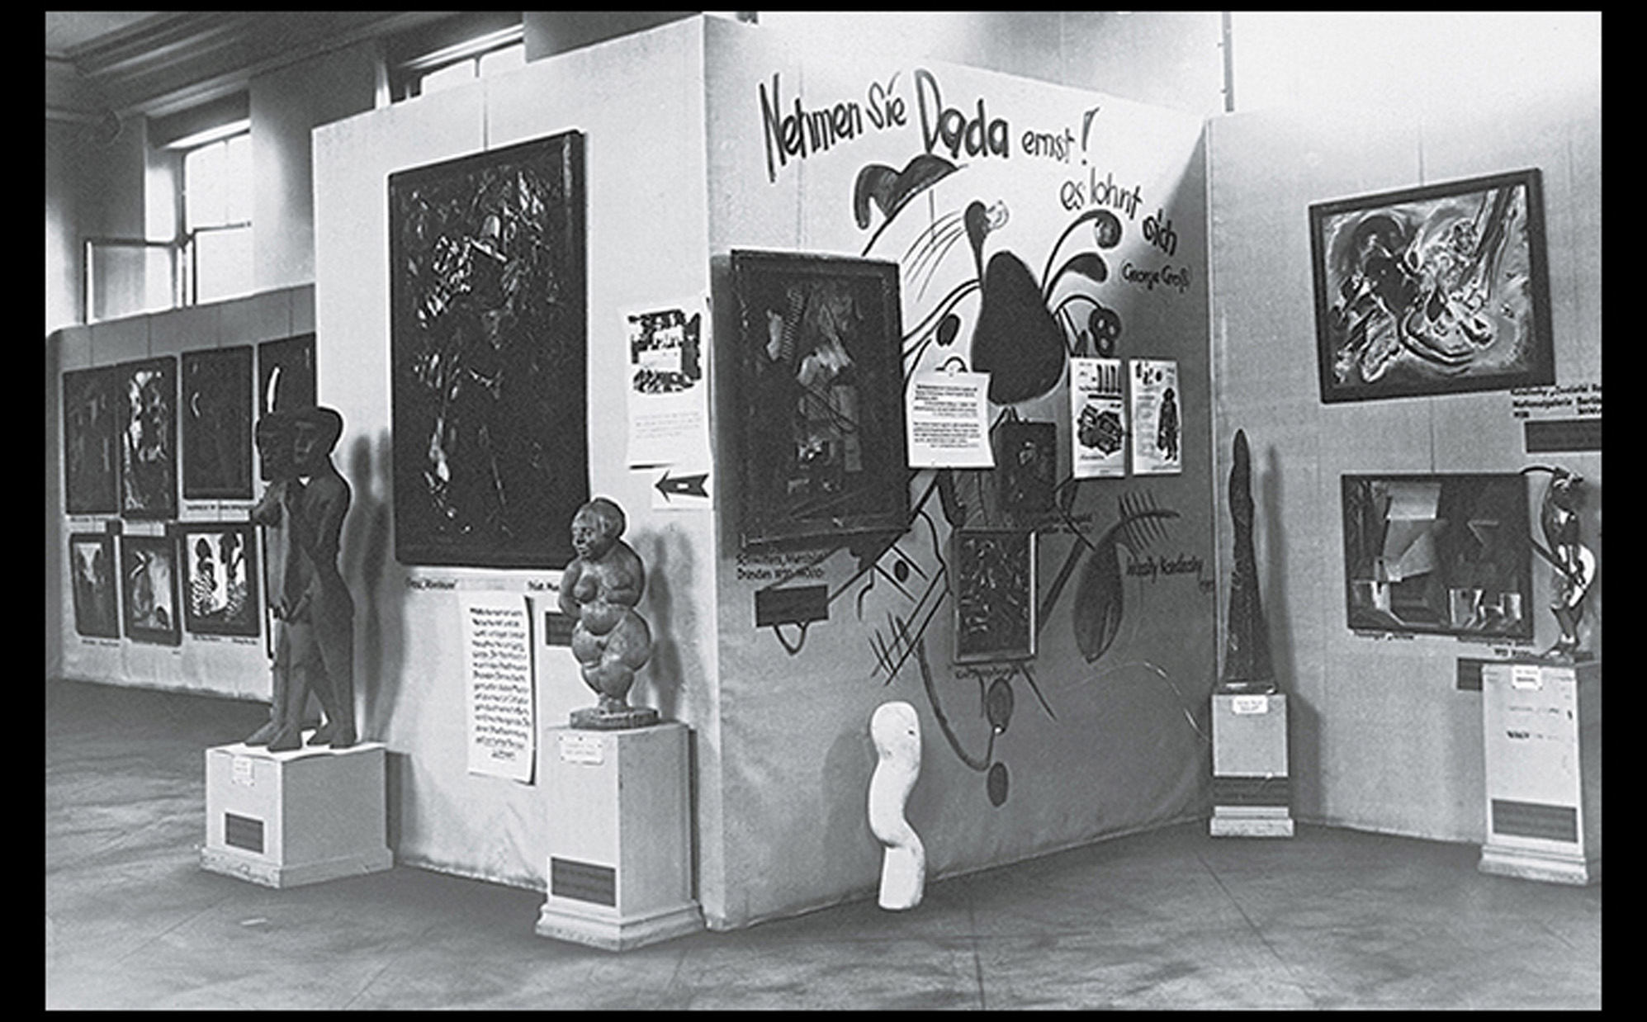
THE DADA WALL IN ROOM 3 OF THE "DEGENERATE ART" ("ENTARTETE KUNST") EXHIBITION Munich. 1937. Art © Estate of George Grosz/Licensed by VAGA, New York. Akademie der Künste/Archiv Bildende Kunst/George Grosz-Archiv.
Notes:
THE DADA WALL IN ROOM 3 OF THE "DEGENERATE ART" ("ENTARTETE KUNST") EXHIBITION Munich. 1937. Art © Estate of George Grosz/Licensed by VAGA, New York. Akademie der Künste/Archiv Bildende Kunst/George Grosz-Archiv.

Slide 25
Surrealism and the Mind (1 of 6)
Initially formed as an off-shoot of Dada and born from the mind of André Breton, Surrealism reflected Freud's theory of warring forces in the unconscious mind.
It was an escape from logic and an effort to improve a war-sick society.

Slide 26
Surrealism and the Mind (2 of 6)
Automatism
This technique was the releasing of the subconscious to create work without rational intervention.
Frottage was a technique of rubbing a pencil or crayon over a textured surface.
Grattage involved layers of paint being laid on a textured surface and emphasizing imagery seen in the natural paint.

Slide 27
Surrealism and the Mind (3 of 6)
Automatism
Max Ernst, who developed the automatist technique, created a nightmarish scene in The Horde.

Slide 28
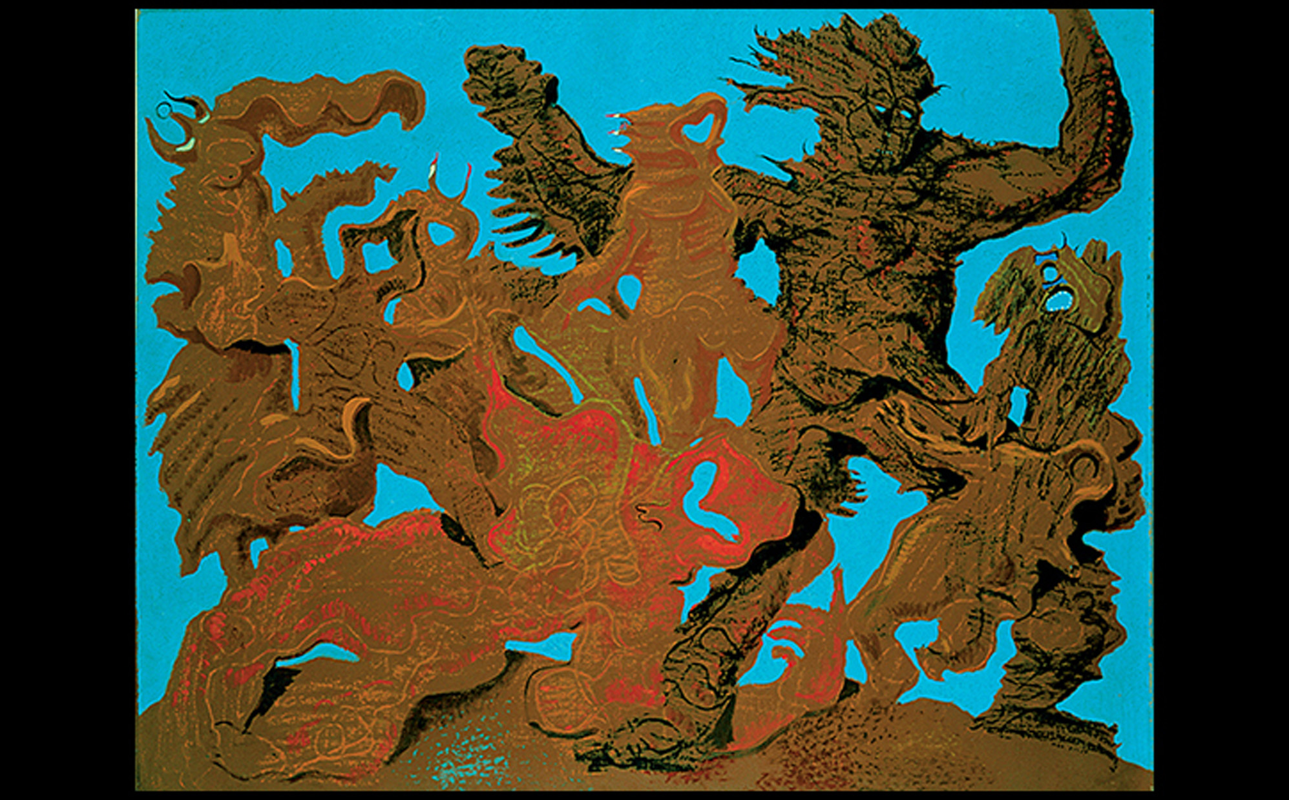
Max Ernst THE HORDE 1927. Oil on canvas, 44-7/8" × 57-1/2" (114 × 146.1 cm). Stedelijk Museum, Amsterdam. © 2016 Artists Rights Society (ARS), New York/ADAGP, Paris. Collection Stedelijk Museum, Amsterdam.
Notes:
Max Ernst THE HORDE 1927. Oil on canvas, 44-7/8" × 57-1/2" (114 × 146.1 cm). Stedelijk Museum, Amsterdam. © 2016 Artists Rights Society (ARS), New York/ADAGP, Paris. Collection Stedelijk Museum, Amsterdam.

Slide 29
Surrealism and the Mind (4 of 6)
Unexpected Juxtapositions
Salvador Dalí paints somewhat recognizable figures and forms but in a style he called the "paranoid–critical method."
Key themes of Dalí's work include sexuality, violence, and putrefaction.
Birth of Liquid Desires illustrates all of these without an aesthetic or moral purpose.

Slide 30
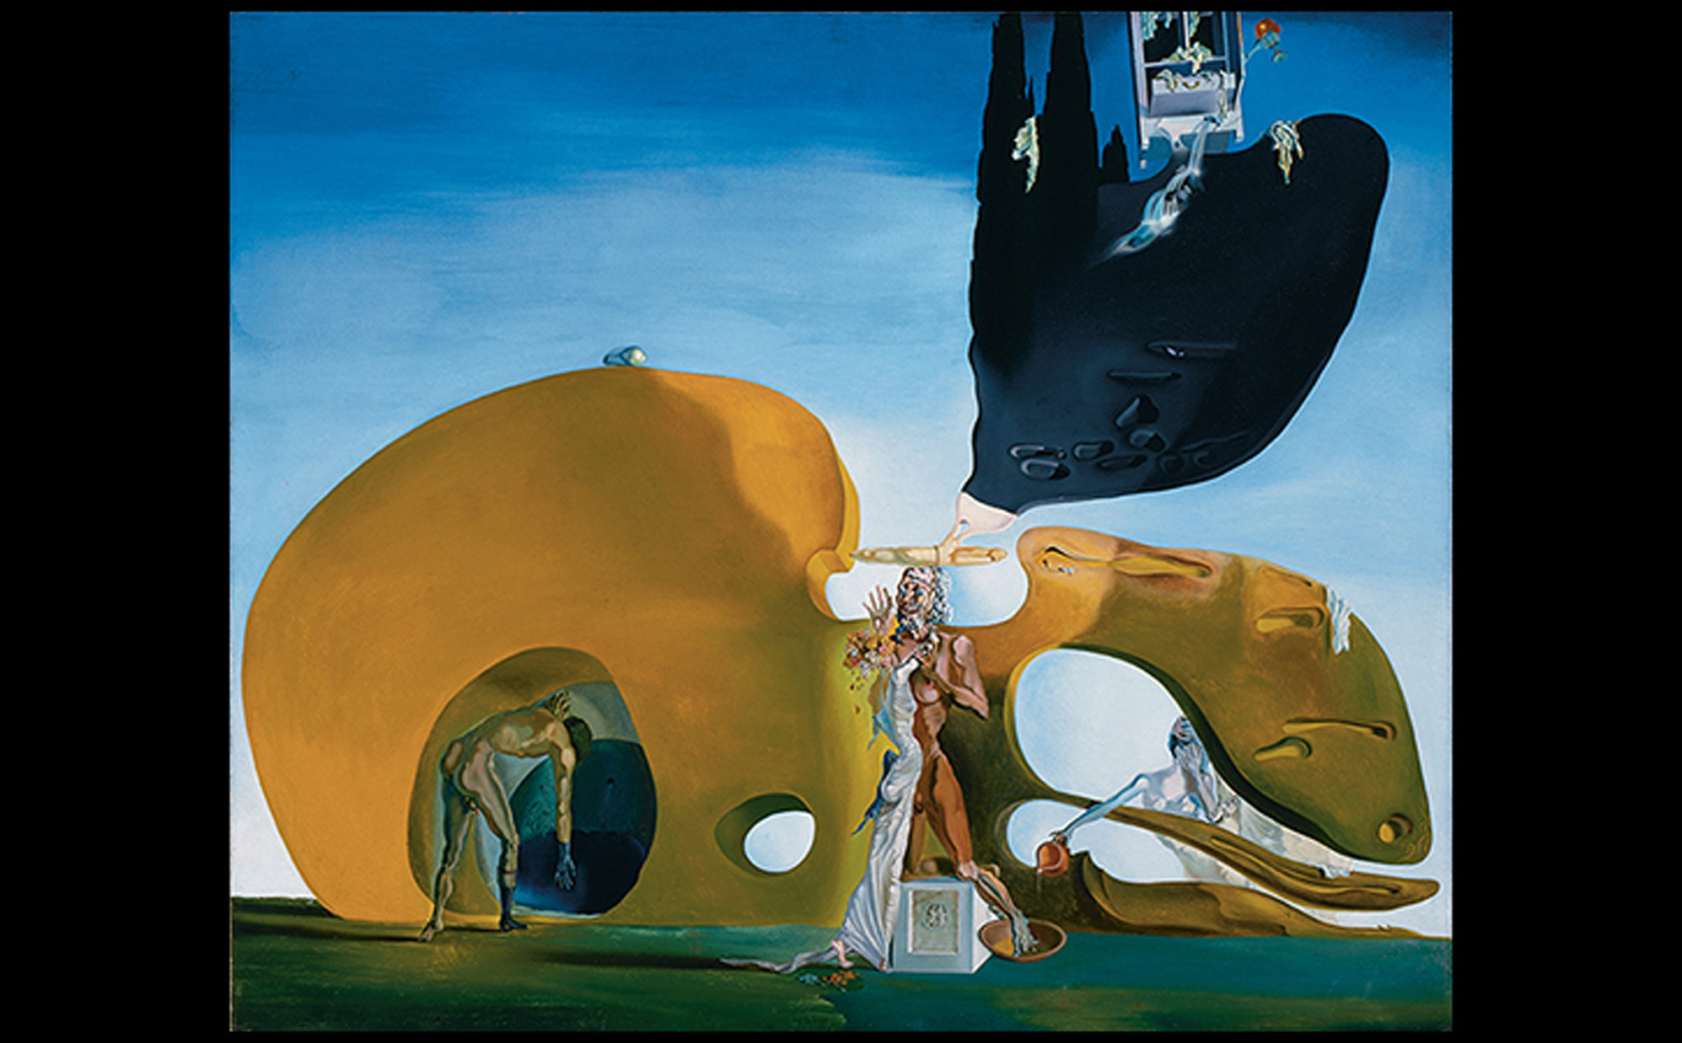
Salvador Dalí BIRTH OF LIQUID DESIRES 1931-1932. Oil and collage on canvas, 37-7/8" × 44-1/4" (96.1 × 112.3 cm). The Solomon R. Guggenheim Foundation. Peggy Guggenheim Collection, Venice 1976 (76.2553 PG 100). © Salvador Dalí, Fundació Gala-Salvador Dalí, Artists Rights Society (ARS), New York 2016. The Solomon R. Guggenheim Foundation/Art Resource, NY.
Notes:
Salvador Dalí BIRTH OF LIQUID DESIRES 1931-1932. Oil and collage on canvas, 37-7/8" × 44-1/4" (96.1 × 112.3 cm). The Solomon R. Guggenheim Foundation. Peggy Guggenheim Collection, Venice 1976 (76.2553 PG 100). © Salvador Dalí, Fundació Gala-Salvador Dalí, Artists Rights Society (ARS), New York 2016. The Solomon R. Guggenheim Foundation/Art Resource, NY.

Slide 31
Surrealism and the Mind (5 of 6)
Unexpected Juxtapositions
Meret Oppenheim produced the disquieting assemblage, Object (Le Déjeuner en Fourrure) both to attract and repel the viewer.

Slide 32
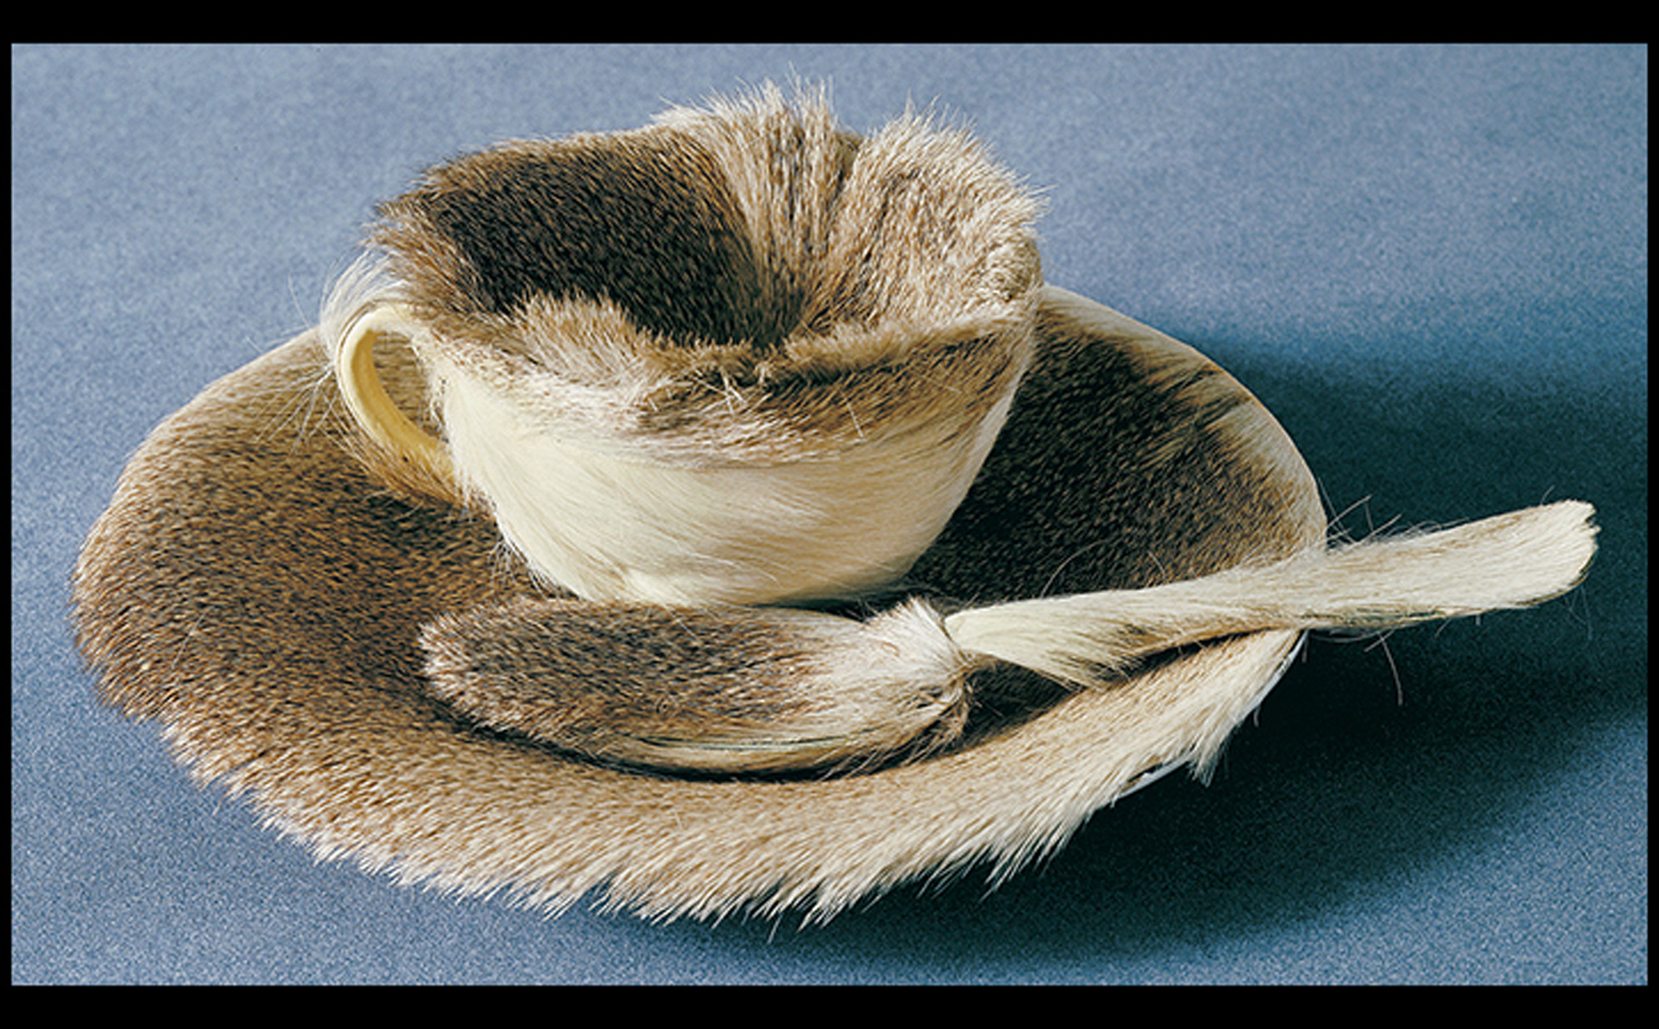
Meret Oppenheim OBJECT (LUNCHEON IN FUR) 1936. Fur-covered cup, diameter 4-3/8" (10.9 cm); fur-covered saucer, diameter 9 3/8" (23.7 cm); fur-covered spoon, length 8" (20.2 cm); overall height, 2-7/8" (7.3 cm). Museum of Modern Art, New York. © 2016 Artists Rights Society (ARS), New York/ProLitteris, Zurich. © 2016. Digital image, The Museum of Modern Art, New York/Scala, Florence.
Notes:
Meret Oppenheim OBJECT (LUNCHEON IN FUR) 1936. Fur-covered cup, diameter 4-3/8" (10.9 cm); fur-covered saucer, diameter 9 3/8" (23.7 cm); fur-covered spoon, length 8" (20.2 cm); overall height, 2-7/8" (7.3 cm). Museum of Modern Art, New York. © 2016 Artists Rights Society (ARS), New York/ProLitteris, Zurich. © 2016. Digital image, The Museum of Modern Art, New York/Scala, Florence.

Slide 33
Surrealism and the Mind (6 of 6)
Bimorphic Abstraction
Joan Miró, in contrast, silhouettes shapes against a hazy background in Composition.
Biomorphic curves evoke organic forms with fluctuating identities.

Slide 34
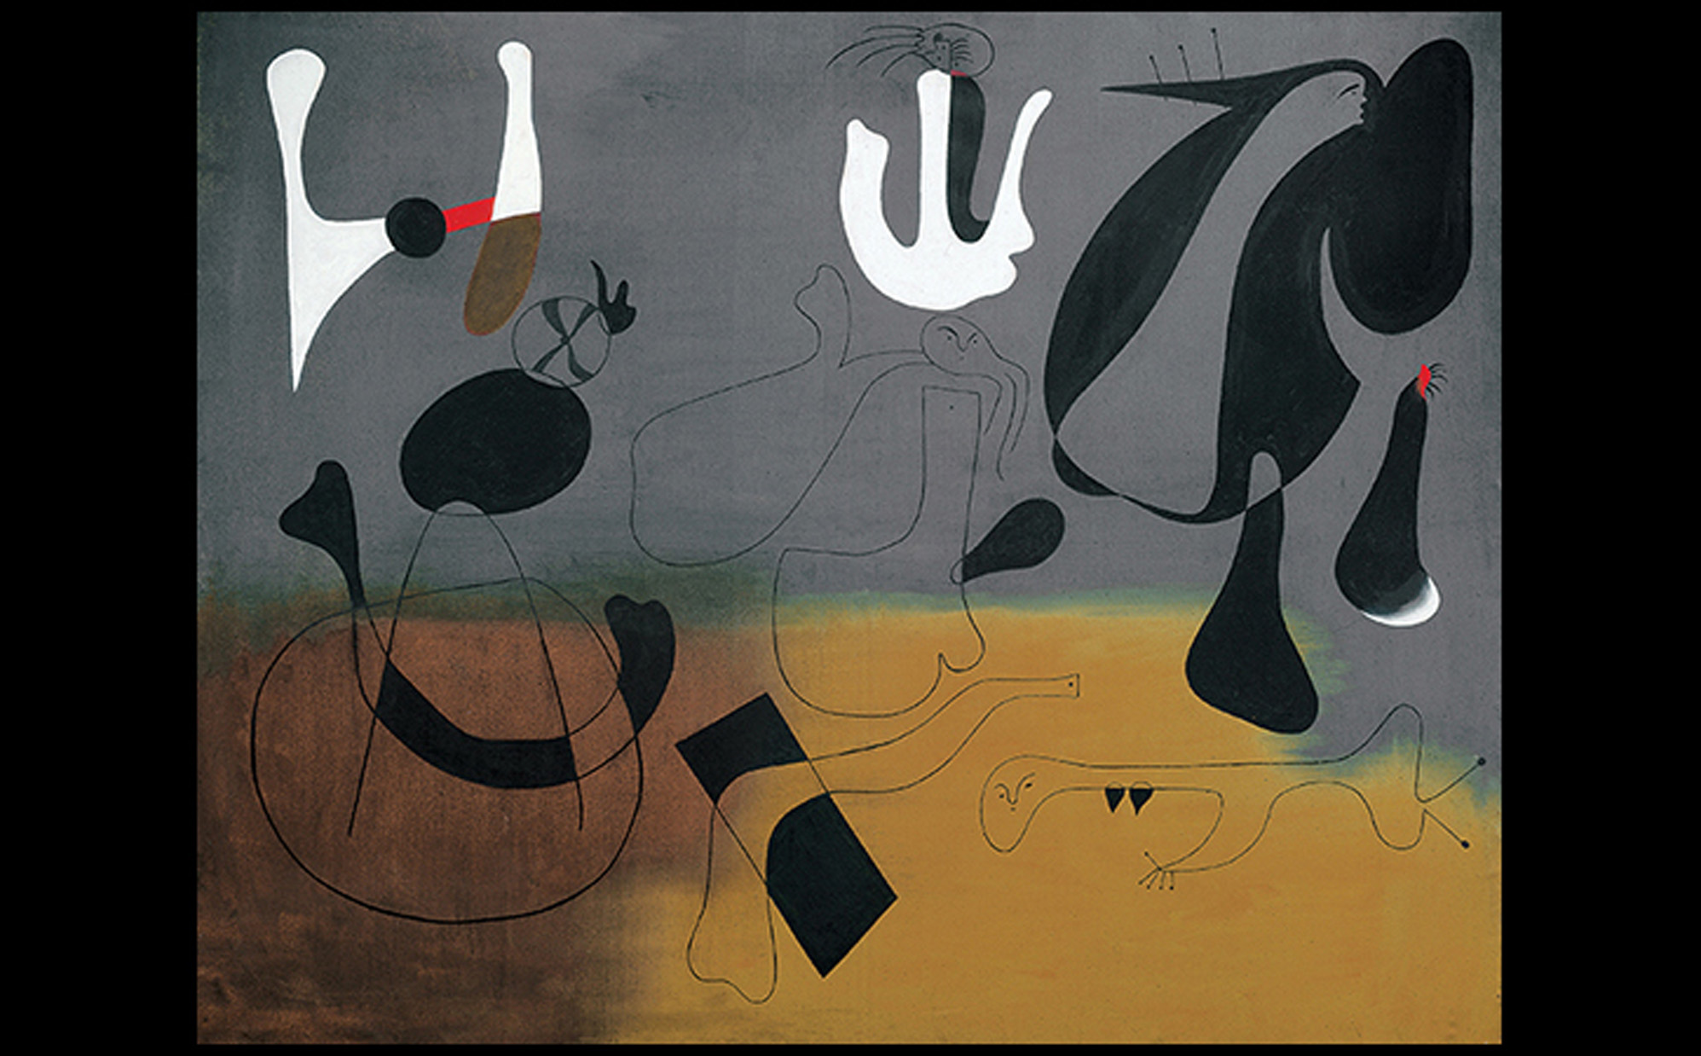
Joan Miró COMPOSITION 1933. Oil on canvas, 51-3/8" × 64-1/8" (130.49 × 162.88 cm). Wadsworth Athenaeum, Hartford, Connecticut. The Ella Gallup Sumner and Mary Catlin Sumner Collection Fund, 1934.40. © Successió Miró/Artists Rights Society (ARS), New York/ADAGP, Paris 2016. Photo: Allen Phillips/Wadsworth Atheneum.
Notes:
Joan Miró COMPOSITION 1933. Oil on canvas, 51-3/8" × 64-1/8" (130.49 × 162.88 cm). Wadsworth Athenaeum, Hartford, Connecticut. The Ella Gallup Sumner and Mary Catlin Sumner Collection Fund, 1934.40. © Successió Miró/Artists Rights Society (ARS), New York/ADAGP, Paris 2016. Photo: Allen Phillips/Wadsworth Atheneum.

Slide 35
Unit One in England (1 of 2)
This group promoted hand-crafted, Surrealist-influenced biomorphic sculptural forms and was founded by Barbara Hepworth, Henry Moore, Paul Nash, and Herbert Reed in 1933.
Hepworth's Forms in Echelon consists of two shapes carved in highly polished wood that allowed viewers to imagine their own meanings.

Slide 36
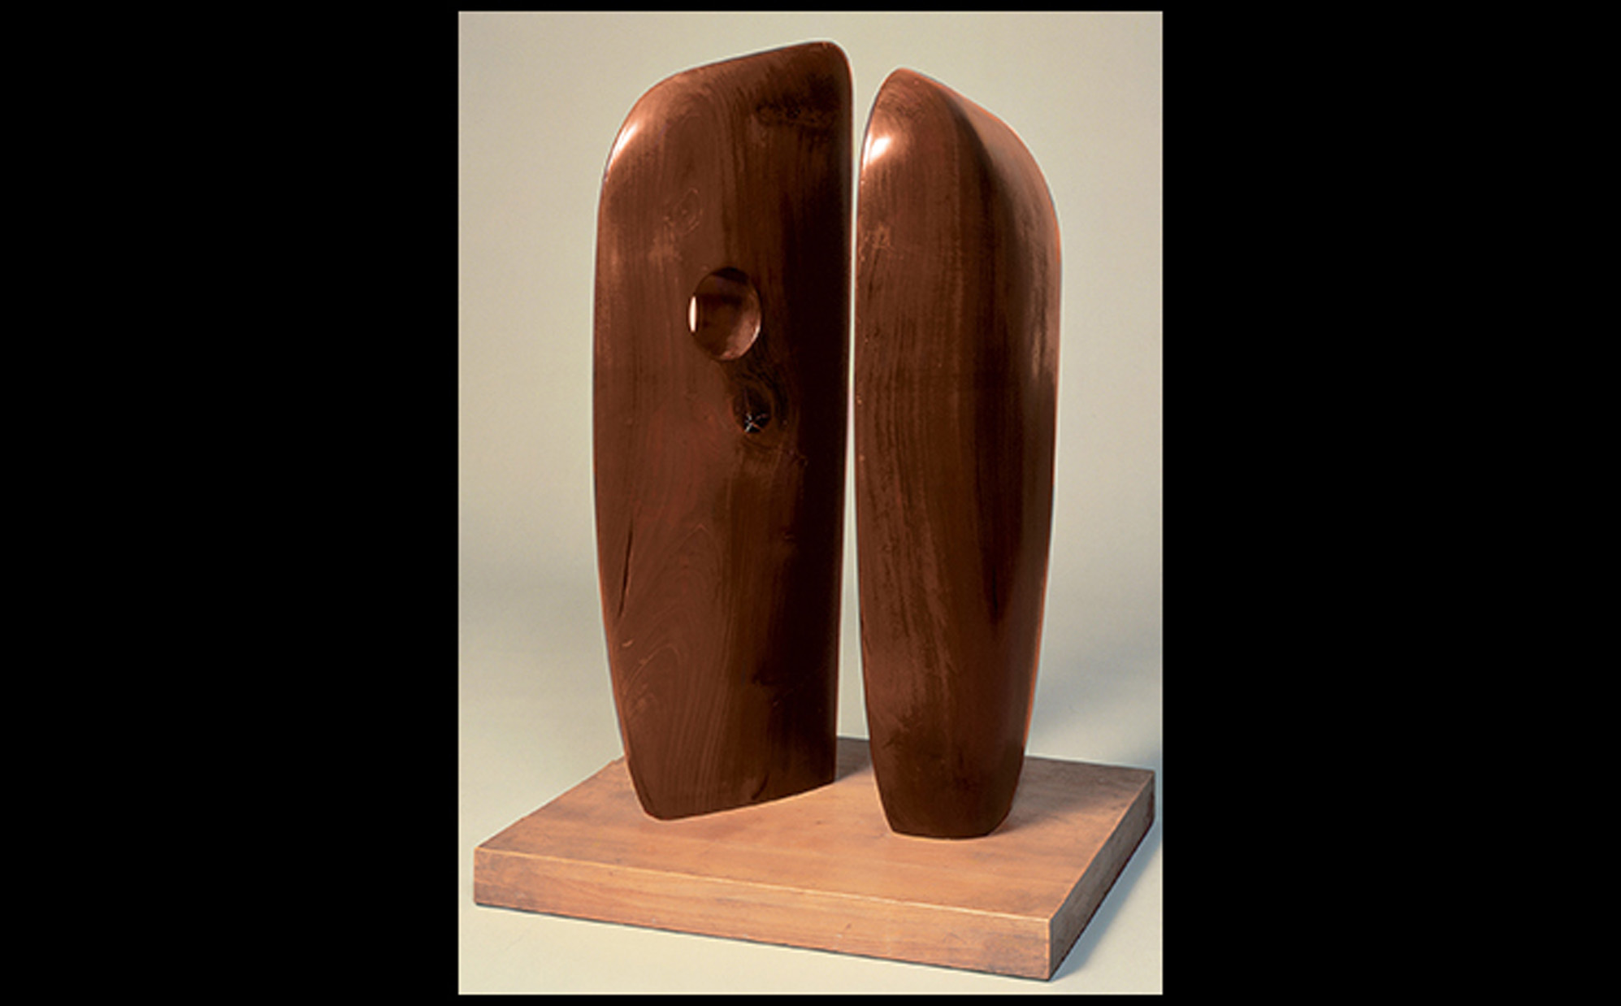
Barbara Hepworth FORMS IN ECHELON 1938. Wood, 42-1/2" × 23-2/3" × 28" (108 × 60 × 71 cm). Tate, London. Presented by the artist 1964. Works by Barbara Hepworth copyright Bowness. © Tate, London 2016.
Notes:
Barbara Hepworth FORMS IN ECHELON 1938. Wood, 42-1/2" × 23-2/3" × 28" (108 × 60 × 71 cm). Tate, London. Presented by the artist 1964. Works by Barbara Hepworth copyright Bowness. © Tate, London 2016.

Slide 37
Unit One in England (2 of 2)
Henry Moore's Recumbent Figure, inspired by the chacmools of Mayan art, orients natural striations to the design harmoniously.
Certain elements are defined while others flow together in an undulating mass more resembling a hill than human.
An open cavity emphasizes the relationship of solid and void.

Slide 38
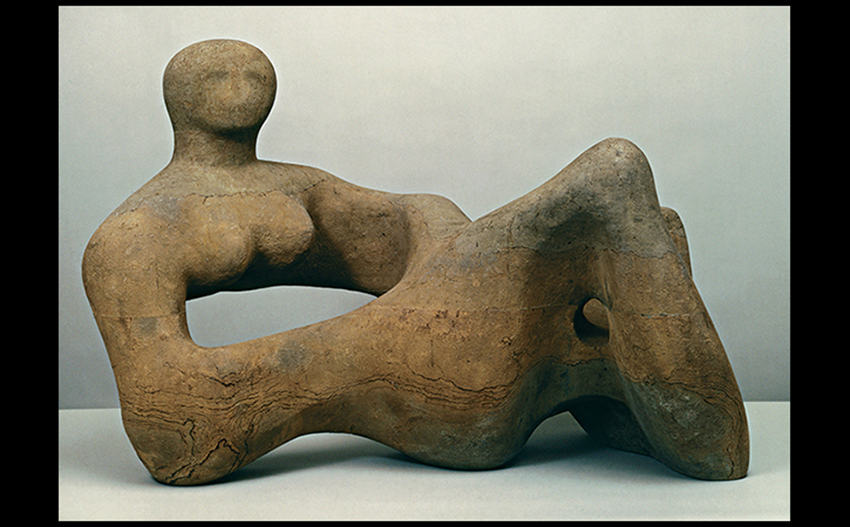
Henry Moore RECUMBENT FIGURE 1938. Green Hornton stone, 35" × 52" × 29" (88.9 × 132.7 × 73.7 cm). Tate, London. © The Henry Moore Foundation. All Rights Reserved, DACS 2016/www.henry-moore.org. Reproduced by permission of The Henry Moore Foundation. © Tate, London 2016.
Notes:
Henry Moore RECUMBENT FIGURE 1938. Green Hornton stone, 35" × 52" × 29" (88.9 × 132.7 × 73.7 cm). Tate, London. © The Henry Moore Foundation. All Rights Reserved, DACS 2016/www.henry-moore.org. Reproduced by permission of The Henry Moore Foundation. © Tate, London 2016.

Slide 39
Picasso's Guernica
Pablo Picasso's 1937 painting commemorates the mass bombing of civilians in the Basque city of Guernica.
The restricted palette of black, gray, and white reflected newspaper photographs that publicized the atrocity.
Distorted victims evoke a heartfelt comment on an international scandal.

Slide 40
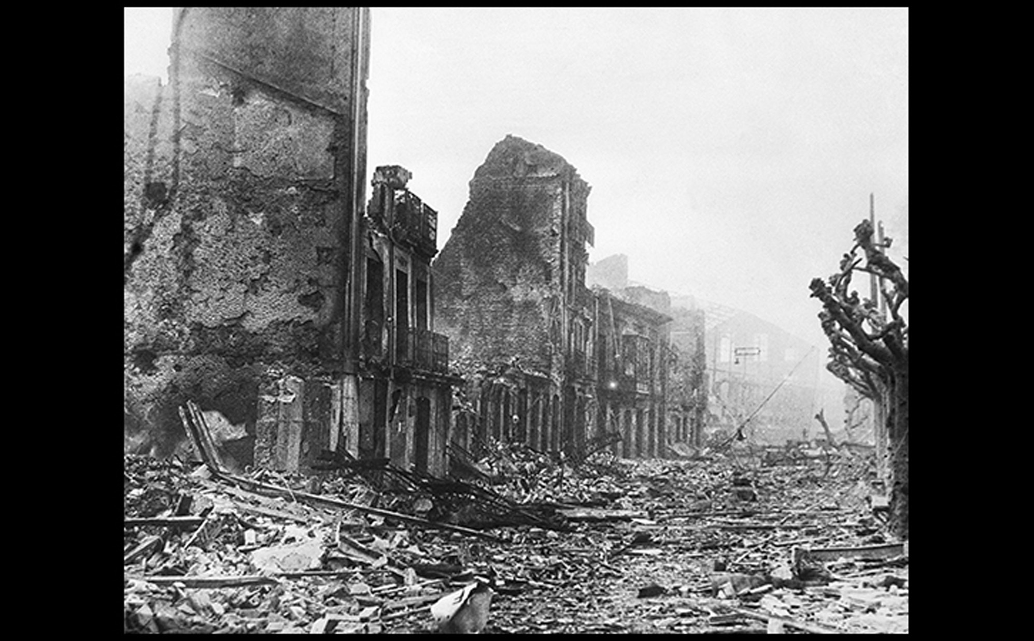
RUINS OF GUERNICA, SPAIN April 1937. © Bettmann/Corbis.
Notes:
RUINS OF GUERNICA, SPAIN April 1937.

Slide 41
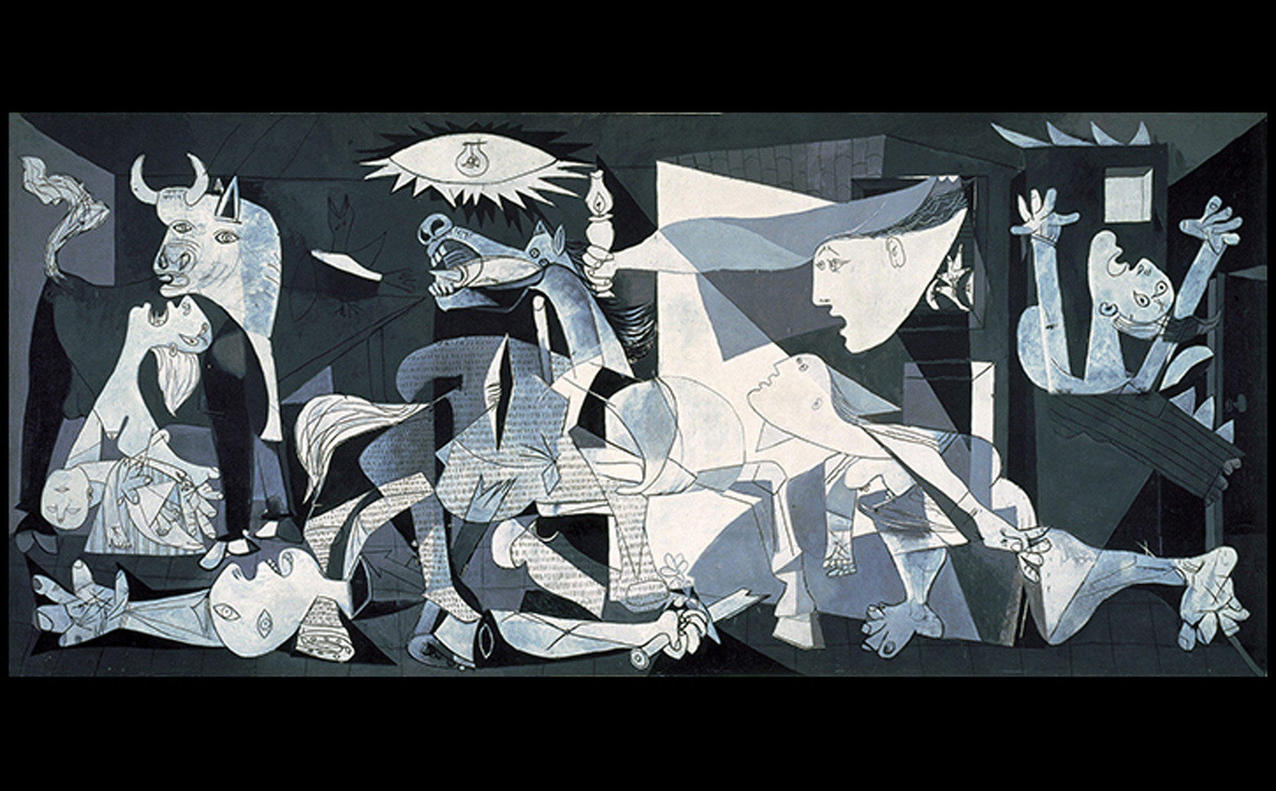
Pablo Picasso GUERNICA 1937. Oil on canvas, 11'6" × 25'8" (3.5 × 7.8 m). Museo Nacional Centro de Arte Reina Sofía, Madrid. On permanent loan from the Museo del Prado, Madrid. © 2016 Estate of Pablo Picasso/Artists Rights Society (ARS), New York.
Notes:
Pablo Picasso GUERNICA 1937. Oil on canvas, 11'6" × 25'8" (3.5 × 7.8 m). Museo Nacional Centro de Arte Reina Sofía, Madrid. On permanent loan from the Museo del Prado, Madrid. © 2016 Estate of Pablo Picasso/Artists Rights Society (ARS), New York.

Slide 42
Art Between the Wars in the Americas
The United States, as a large nation with diverse, multiple "identities," encountered a need for a national visual identity separate from an Anglo-Saxon, male profile.
Works of art by women, African Americans, immigrants, and other outliers came to the fore.

Slide 43
The Harlem Renaissance (1 of 4)
The Great Migration of agricultural Southern African Americans to the North prompted the "New Negro" movement.
The intellectual leader of the movement was Alain Locke, a critic and philosophy professor urging black artists and writers to seek their artistic roots in the traditional arts of Africa.

Slide 44
The Harlem Renaissance (2 of 4)
James VanDerZee created positive, non-stereotypical images that proclaimed racial pride and social empowerment.
He depicted the "New Negro" man and woman in Couple Wearing Raccoon Coats with a Cadillac.

Slide 45
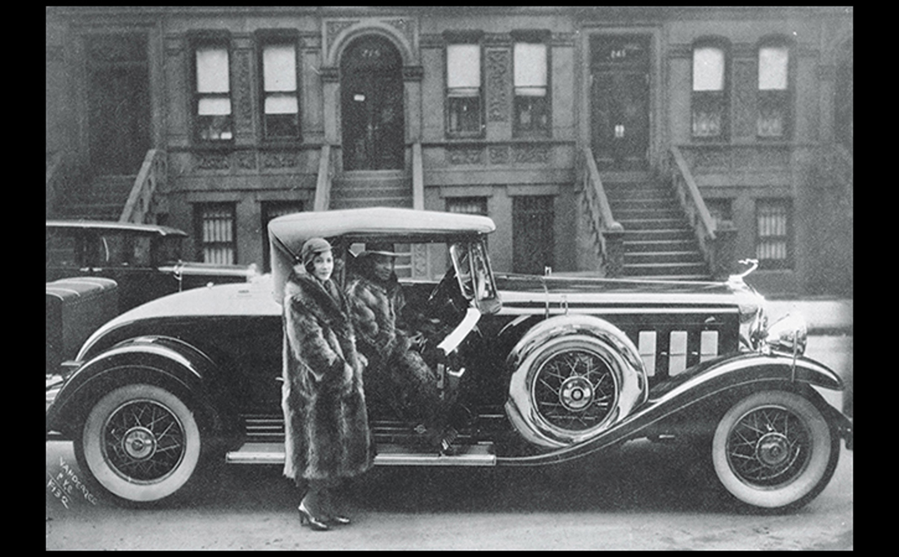
James Van Der Zee COUPLE WEARING RACCOON COATS WITH A CADILLAC, TAKEN ON WEST 127TH STREET, HARLEM, NEW YORK 1932. Gelatin-silver print. © Donna Mussenden VanDerZee.
Notes:
James Van Der Zee COUPLE WEARING RACCOON COATS WITH A CADILLAC, TAKEN ON WEST 127TH STREET, HARLEM, NEW YORK 1932. Gelatin-silver print. © Donna Mussenden VanDerZee. [Fig. 32-65

Slide 46
The Harlem Renaissance (3 of 4)
Aaron Douglas developed an abstract style based on silhouetted figures from African art.
He limited his palate to subtle hues that varied in value.
Aspects of Negro Life... intended to awaken a sense of the African American's place in history.
The heroic orator at center remains the focus, encouraging continued efforts.

Slide 47
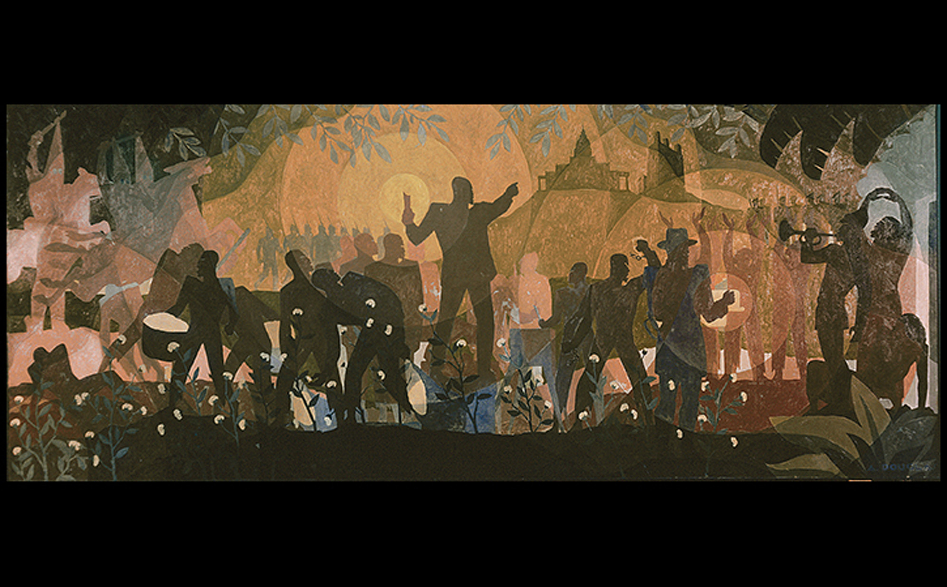
Aaron Douglas ASPECTS OF NEGRO LIFE: FROM SLAVERY THROUGH RECONSTRUCTION 1934. Oil on canvas, 5' × 11'7" (1.5 × 3.5 m). Schomburg Center for Research in Black Culture, New York Public Library. Art © Heirs of Aaron Douglas/Licensed by VAGA, New York, NY. Schomburg Center, NYPL/Art Resource, NY.
Notes:
Aaron Douglas ASPECTS OF NEGRO LIFE: FROM SLAVERY THROUGH RECONSTRUCTION 1934. Oil on canvas, 5' × 11'7" (1.5 × 3.5 m). Schomburg Center for Research in Black Culture, New York Public Library. Art © Heirs of Aaron Douglas/Licensed by VAGA, New York, NY. Schomburg Center, NYPL/Art Resource, NY.

Slide 48
The Harlem Renaissance (4 of 4)
Sculptor Augusta Savage was denied a scholarship at Cooper Union because of her race.
La Citadelle: Freedom portrays a female figure balancing on her toes as a symbol of the promise of equality.
Jacob Lawrence's The Migration Series narrates the exodus of African Americans to the north in 60 panels.

Slide 49
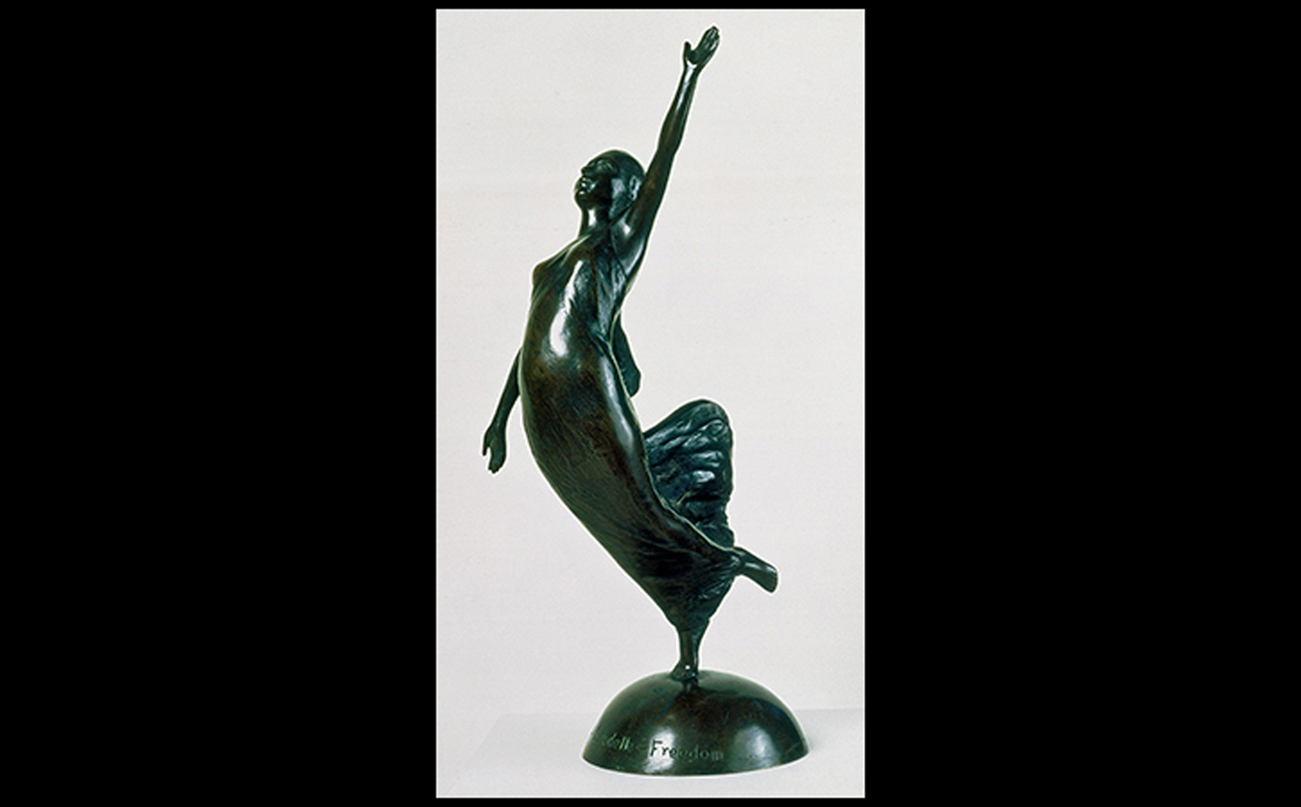
Augusta Savage LA CITADELLE: FREEDOM 1930. Bronze, 14-1/2" × 7" × 6" (35.6 × 17.8 × 15.2 cm). Howard University Gallery of Art, Washington, DC. © Augusta Savage.
Notes:
Augusta Savage LA CITADELLE: FREEDOM 1930. Bronze, 14-1/2" × 7" × 6" (35.6 × 17.8 × 15.2 cm). Howard University Gallery of Art, Washington, DC. © Augusta Savage.

Slide 50
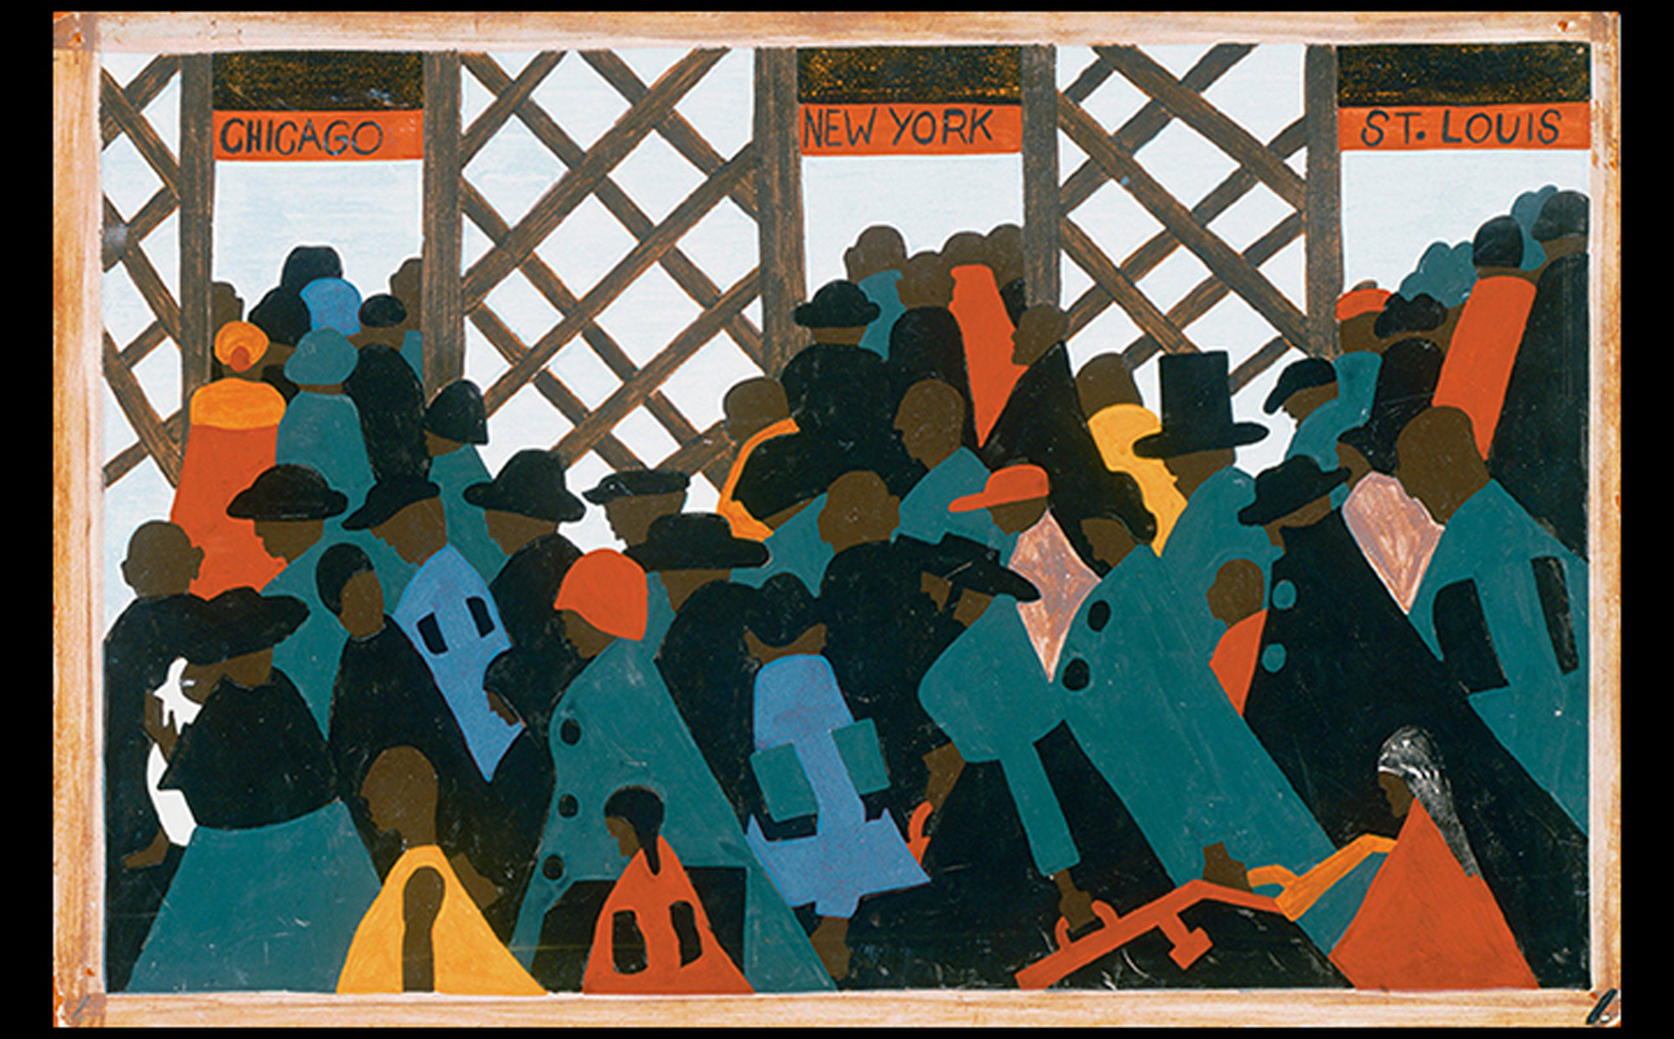
Jacob Lawrence THE MIGRATION SERIES, PANEL NO. 1: DURING WORLD WAR I THERE WAS A GREAT MIGRATION NORTH BY SOUTHERN AFRICAN AMERICANS 1940–1941. Tempera on masonite, 12" × 18" (30.5 × 45.7 cm). The Phillips Collection, Washington, DC. © 2016 The Jacob and Gwendolyn Knight Lawrence Foundation, Seattle/Artists Rights Society (ARS), New York.
Notes:
Jacob Lawrence THE MIGRATION SERIES, PANEL NO. 1: DURING WORLD WAR I THERE WAS A GREAT MIGRATION NORTH BY SOUTHERN AFRICAN AMERICANS 1940–1941. Tempera on masonite, 12" × 18" (30.5 × 45.7 cm). The Phillips Collection, Washington, DC. © 2016 The Jacob and Gwendolyn Knight Lawrence Foundation, Seattle/Artists Rights Society (ARS), New York.

Slide 51
Rural America (1 of 2)
American Scene Painting, especially under the Regionalists, took sympathetic attitudes toward subjects.
Grant Wood, in his iconic American Gothic, shows a pair with a pitchfork standing in front of a "Carpenter Gothic"-style house, a sincerely affectionate portrait of small-town Iowa.

Slide 52
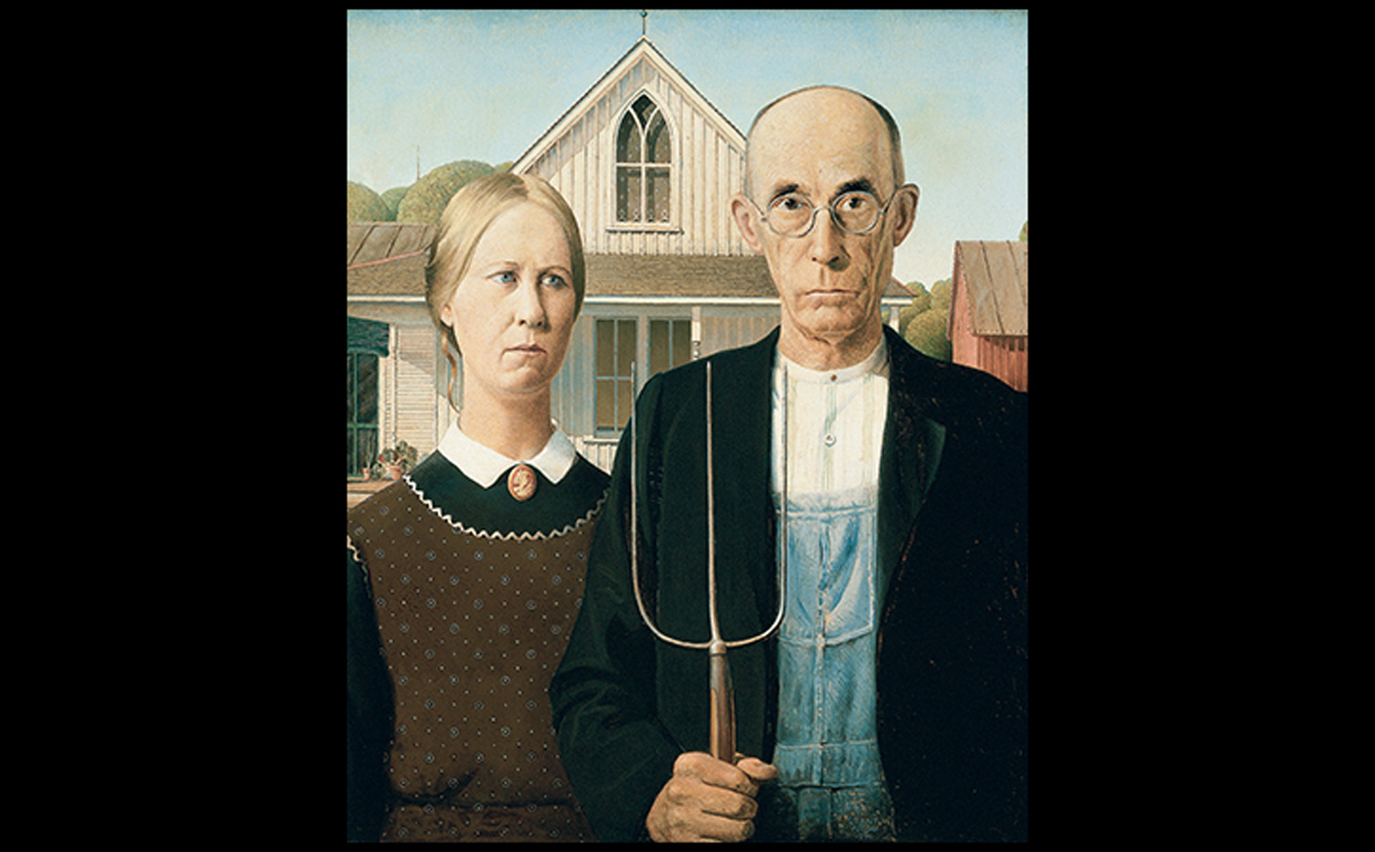
Grant Wood AMERICAN GOTHIC 1930. Oil on beaverboard, 29-7/8" × 24-7/8" (74.3 × 62.4 cm). The Art Institute of Chicago. Friends of American Art Collection, 1930.934. Art © Figge Art Museum, successors to the Estate of Nan Wood Graham/Licensed by VAGA, New York, NY. Photo © The Art Institute of Chicago.
Notes:
Grant Wood AMERICAN GOTHIC 1930. Oil on beaverboard, 29-7/8" × 24-7/8" (74.3 × 62.4 cm). The Art Institute of Chicago. Friends of American Art Collection, 1930.934. Art © Figge Art Museum, successors to the Estate of Nan Wood Graham/Licensed by VAGA, New York, NY. Photo © The Art Institute of Chicago

Slide 53
Rural America (2 of 2)
Federal Patronage for American Art During the Depression
The Farm Securities Administration (FSA) began to hire photographers to document the problems of farmers and migrant workers in 1935.
Dorothea Lange collaborated, touched by the struggles of the poor and unemployed; her most famous picture is Migrant Mother, Nipomo, California.

Slide 54
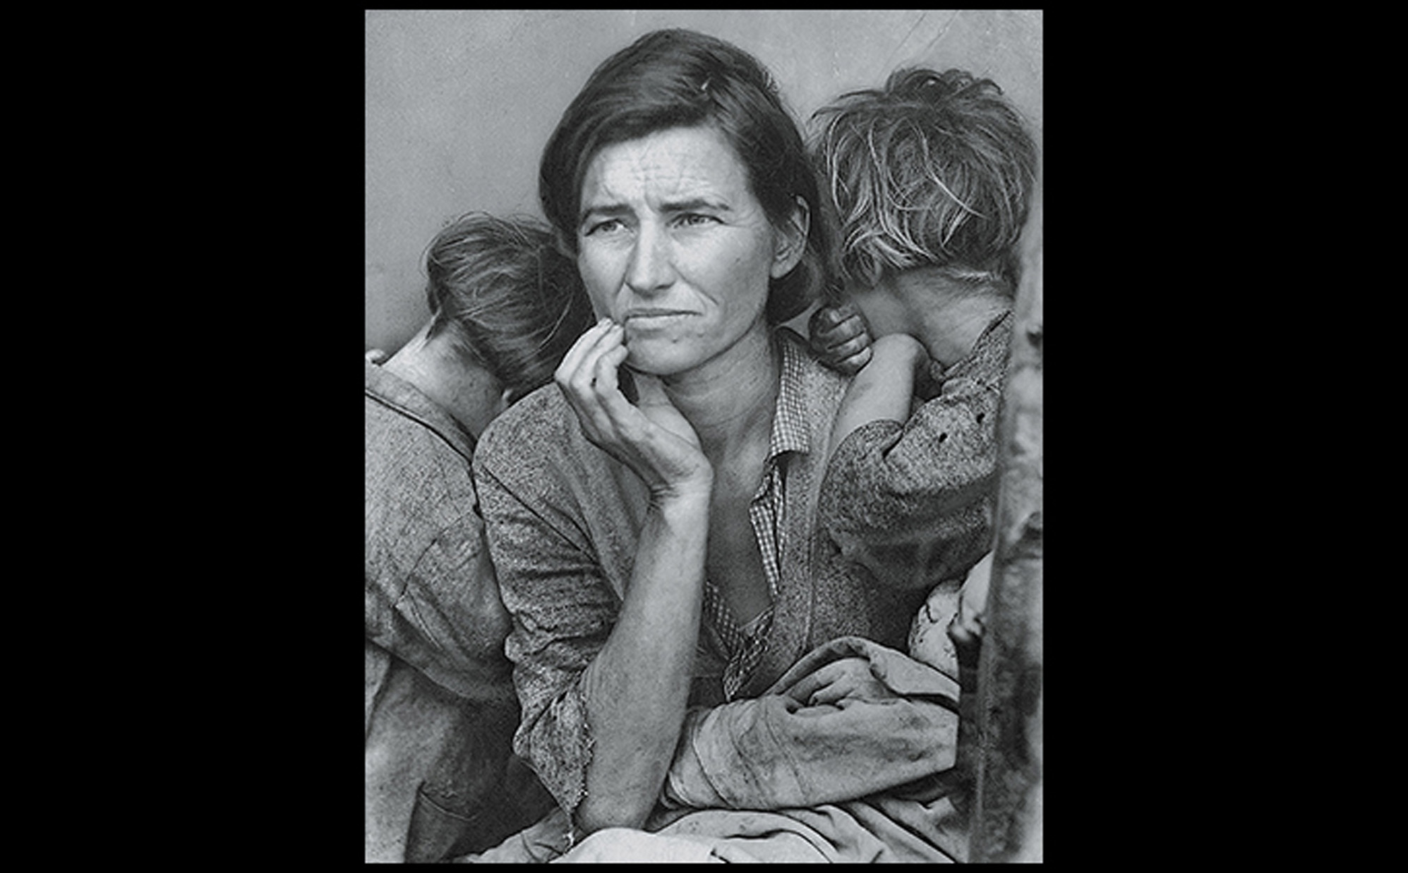
Dorothea Lange MIGRANT MOTHER, NIPOMO, CALIFORNIA February 1936. Gelatin-silver print. Library of Congress, Washington, DC. Courtesy the Library of Congress.
Notes:
Dorothea Lange MIGRANT MOTHER, NIPOMO, CALIFORNIA February 1936. Gelatin-silver print. Library of Congress, Washington, DC. Courtesy the Library of Congress.

Slide 55
Canada (1 of 3)
The subject of Canada's untamed wilderness became a point through which Canadian artists could assert independence from European art.
Some painters employed academic realism while others utilized Impressionism.

Slide 56
Canada (2 of 3)
Landscape and Identity
Tom Thomson's The West Wind features a lone, stylized pine tree rising from a landscape with reverential divinity.
It became an icon in Canadian art.
The artist often made numerous oil-on-board sketches for the basis of paintings that he executed during winter.

Slide 57
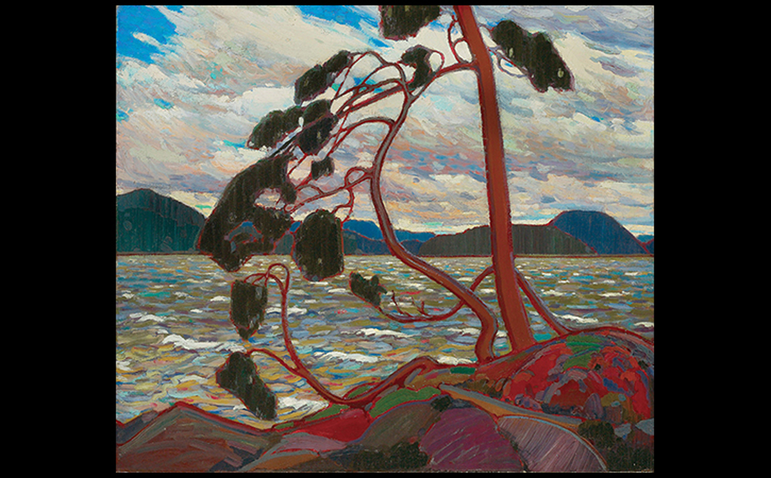
Tom Thomson THE WEST WIND Winter 1916/1917. Oil on canvas, 451⁄2 × 54″ (120.7 × 137.9 cm). Art Gallery of Ontario, Toronto. Gift of Canadian Club of Toronto, 1926 #784. © akg-images.
Notes:
Tom Thomson THE WEST WIND Winter 1916/1917. Oil on canvas, 451⁄2 × 54″ (120.7 × 137.9 cm). Art Gallery of Ontario, Toronto. Gift of Canadian Club of Toronto, 1926 #784. © akg-images.

Slide 58
Canada (3 of 3)
Native American Influence
As a partner to the Group of Seven, Emily Carr developed a dark, brooding style.
Big Raven shows a surviving, carved raven that originally marked a mortuary house.

Slide 59
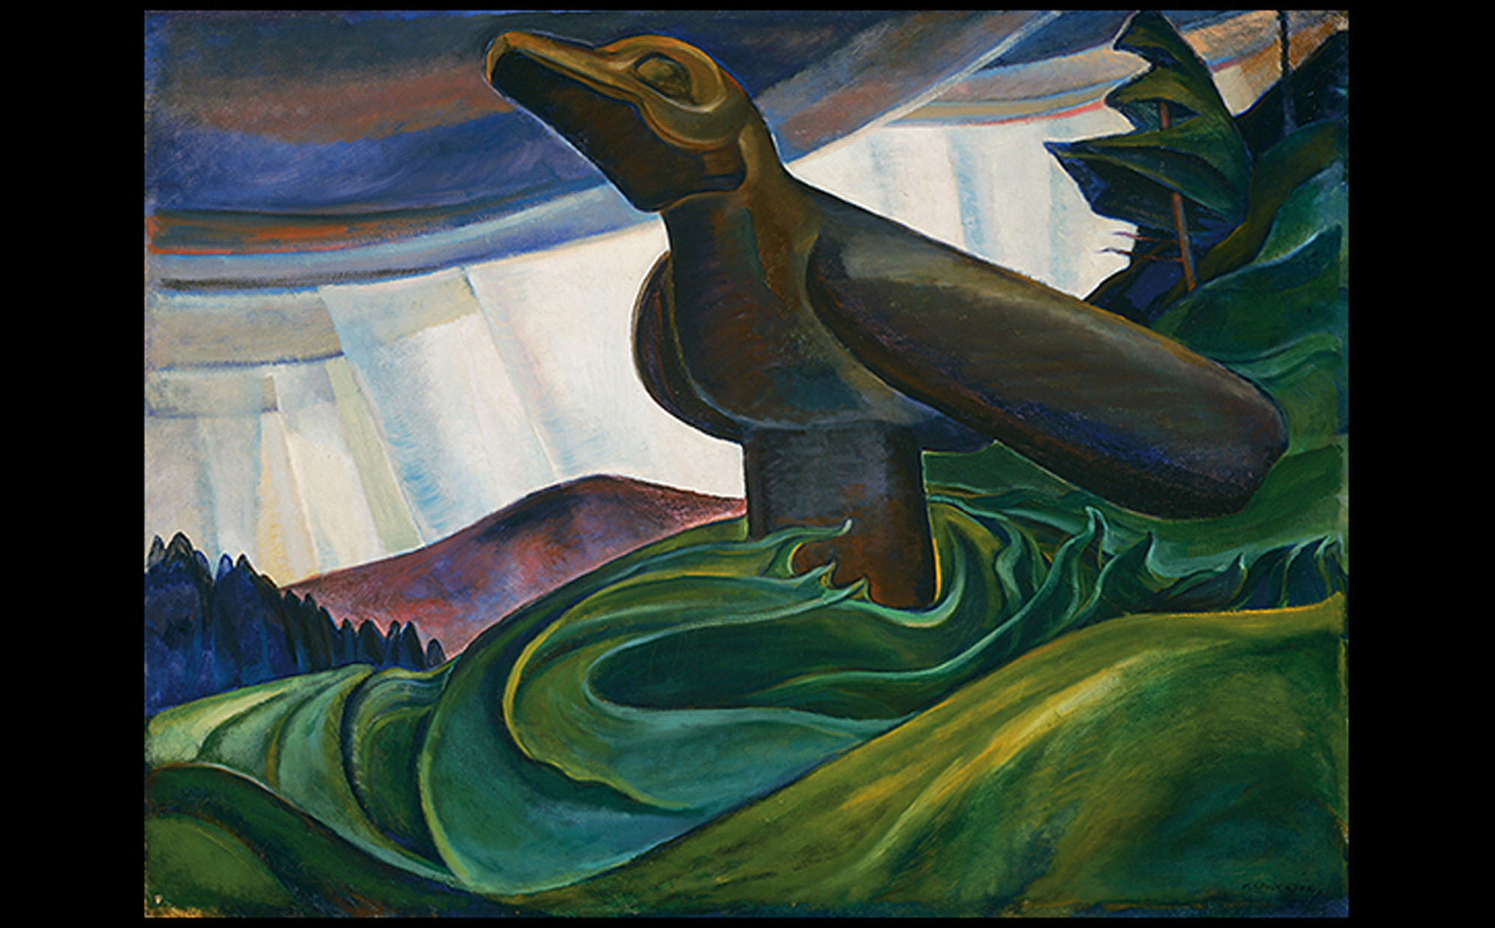
Emily Carr BIG RAVEN 1931. Oil on canvas, 34-1/4" × 44-7/8" (87 × 114 cm). Collection of the Vancouver Art Gallery, Emily Carr Trust. Vancouver Art Gallery, Photo: Trevor Mills .
Notes:
Emily Carr BIG RAVEN 1931. Oil on canvas, 34-1/4" × 44-7/8" (87 × 114 cm). Collection of the Vancouver Art Gallery, Emily Carr Trust. Vancouver Art Gallery, Photo: Trevor Mills .

Slide 60
Mexico, Brazil, and Cuba (1 of 5)
The Mexican Revolution of 1910 brought ten years of political instability.
Artists entered service of the state with several public building mural commissions.

Slide 61
Mexico, Brazil, and Cuba (2 of 5)
Prominent in the Mexican mural movement was Diego Rivera, who studied Synthetic Cubist style.
The Great City of Tenochtitlan was painted for a mural cycle portraying the history of Mexico in the National Palace in Mexico City.

Slide 62
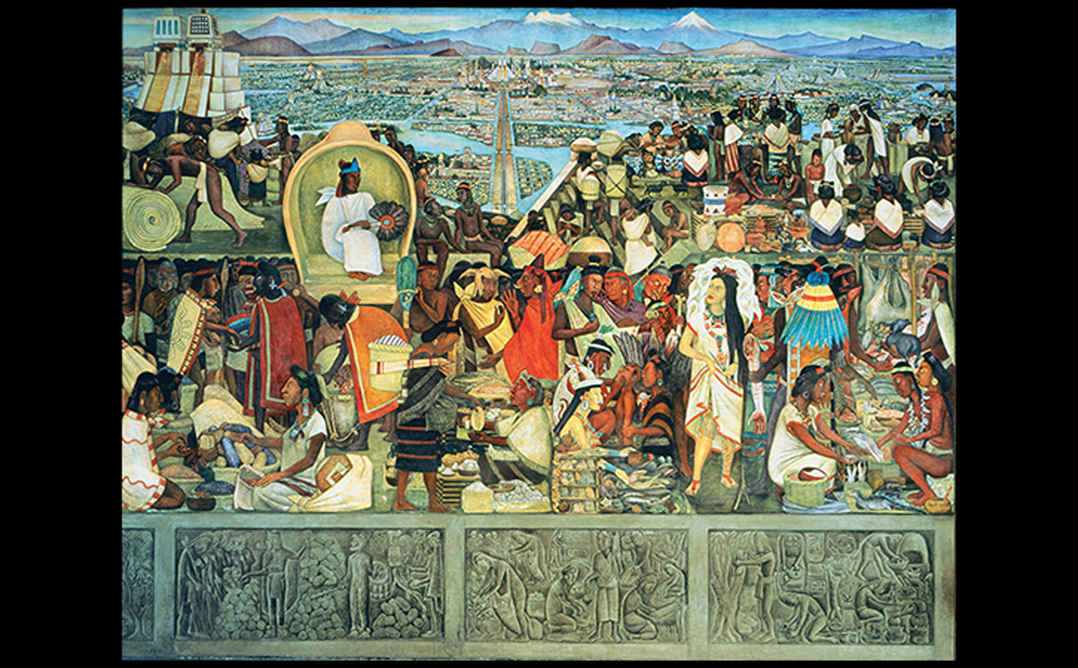
Diego Rivera THE GREAT CITY OF TENOCHTITLAN (DETAIL) Mural in patio corridor, National Palace, Mexico City. 1945. Fresco, 16'1-3/4" × 31'10-1/4" (4.92 × 9.71 m). © 2016 Banco de México Diego Rivera Frida Kahlo Museums Trust, Mexico, D.F./Artists Rights Society (ARS), New York. © 2016. Photo Art Resource/Bob Schalkwijk/Scala, Florence.
Notes:
Diego Rivera THE GREAT CITY OF TENOCHTITLAN (DETAIL) Mural in patio corridor, National Palace, Mexico City. 1945. Fresco, 16'1-3/4" × 31'10-1/4" (4.92 × 9.71 m). © 2016 Banco de México Diego Rivera Frida Kahlo Museums Trust, Mexico, D.F./Artists Rights Society (ARS), New York. © 2016. Photo Art Resource/Bob Schalkwijk/Scala, Florence.

Slide 63
Mexico, Brazil, and Cuba (3 of 5)
More private, introspective statements were made by Mexican artists on easel paintings.
Frida Kahlo presented a split ethnic identity in The Two Fridas.
Between the two Fridas (one dressed in Victorian dress, and the other in Mexican clothing), an artery runs between them, beginning at a miniature portrait of Diego Rivera, whom she was divorcing.

Slide 64
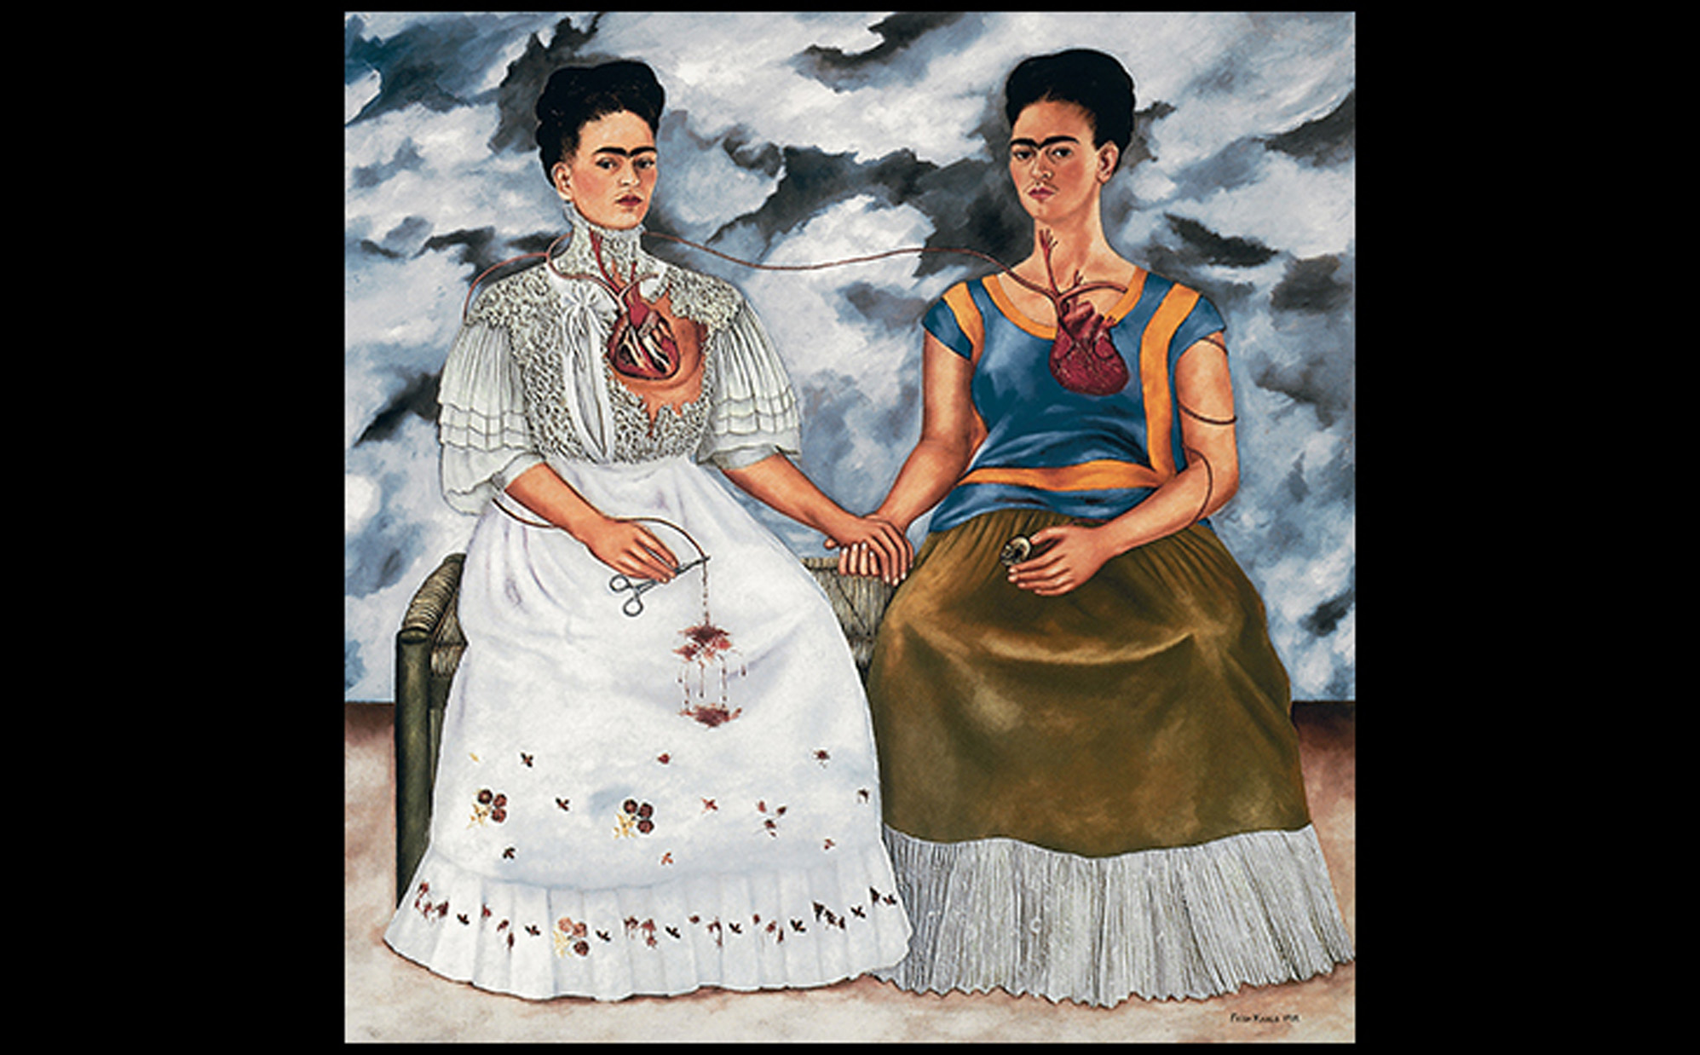
Frida Kahlo THE TWO FRIDAS 1939. Oil on canvas, 5'8-1/2" × 5'8-1/2" (1.74 × 1.74 m). Museo de Arte Moderno, Instituto Nacional de Bellas Artes, Mexico City. © 2016 Banco de México Diego Rivera Frida Kahlo Museums Trust, Mexico, D.F./Artists Rights Society (ARS), New York. © 2016. Photo Art Resource/Bob Schalkwijk/Scala, Florence.
Notes:
Frida Kahlo THE TWO FRIDAS 1939. Oil on canvas, 5'8-1/2" × 5'8-1/2" (1.74 × 1.74 m). Museo de Arte Moderno, Instituto Nacional de Bellas Artes, Mexico City. © 2016 Banco de México Diego Rivera Frida Kahlo Museums Trust, Mexico, D.F./Artists Rights Society (ARS), New York. © 2016. Photo Art Resource/Bob Schalkwijk/Scala, Florence.

Slide 65
Mexico, Brazil, and Cuba (4 of 5)
Brazil
Art in other parts of Latin America was dominated by the academic tradition of the nineteenth century.
Modern Art Week was an event Brazilian artists used as a way to declare independence from Europe.
Tarsila do Amaral created the abstract Abaporú (The One Who Eats) in homage to Léger and Brancusi.

Slide 66
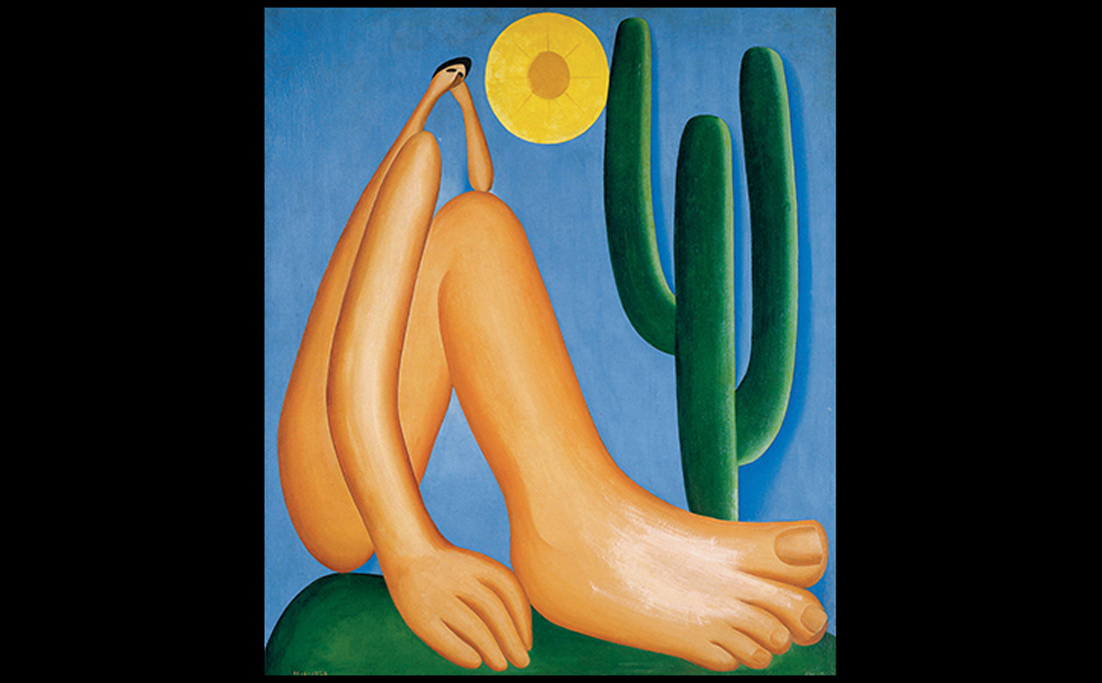
Tarsila do Amaral THE ONE WHO EATS (ABAPORÚ) 1928. Oil on canvas, 34" × 29" (86.4 × 73.7 cm). Museo de Arte Latinoamericano, Buenos Aires. Courtesy of Guilherme Augusto do Amaral/Malba-Coleccion Constantini, Buenos Aires. © Tarsila do Amara. Collection of MALBA, Museo de Arte Latinoamericano de Buenos Aires.
Notes:
Tarsila do Amaral THE ONE WHO EATS (ABAPORÚ) 1928. Oil on canvas, 34" × 29" (86.4 × 73.7 cm). Museo de Arte Latinoamericano, Buenos Aires. Courtesy of Guilherme Augusto do Amaral/Malba-Coleccion Constantini, Buenos Aires. © Tarsila do Amara. Collection of MALBA, Museo de Arte Latinoamericano de Buenos Aires.

Slide 67
Mexico, Brazil, and Cuba (5 of 5)
Cuba
"Minority" artists pursued a popular, Modern art with Cuban roots.
Amelia Peláez studied popular and folk arts with a focus on the woman's realm and national identity.
The visual language of Marpacífico is Cubist, but shows recognizable objects and pure color.

Slide 68
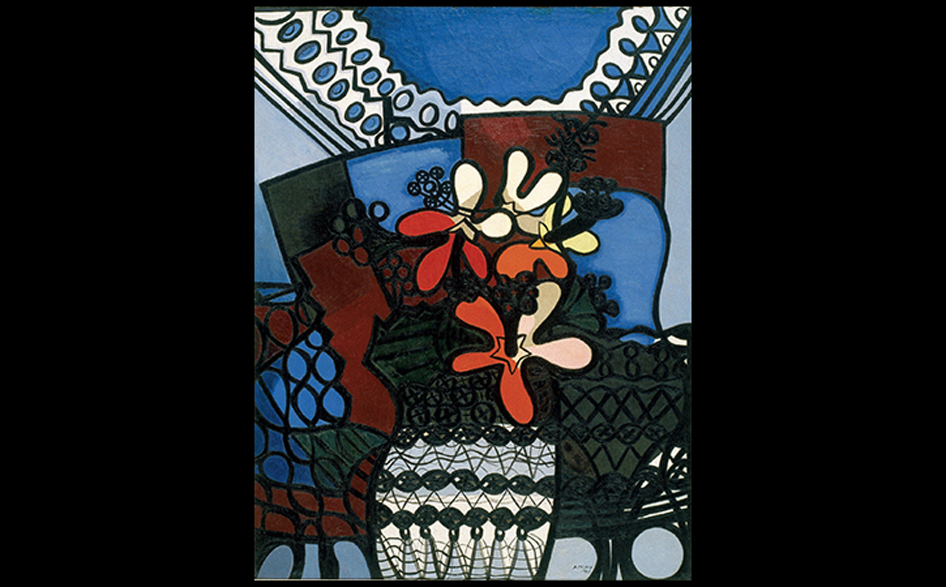
Amelia Peláez HIBISCUS (MARPACÍFICO) 1943. Oil on canvas, 45-1/2" × 35" (115.6 × 88.9 cm). Collection OAS Art Museum of the Americas, Washington, DC. Gift of IBM. © Amelia Pelaez Foundation.
Notes:
Amelia Peláez HIBISCUS (MARPACÍFICO) 1943. Oil on canvas, 45-1/2" × 35" (115.6 × 88.9 cm). Collection OAS Art Museum of the Americas, Washington, DC. Gift of IBM. © Amelia Pelaez Foundation.

Slide 69
Figural Responses and Art Informel in Europe (1 of 2)
Most immediately postwar art involved figural or abstracted works attempting to cope with the horrors of war.
Francis Bacon's Head Surrounded by Sides of Beef portrays Pope Innocent X as an anguished and insubstantial man.
It was directly inspired by Diego Velásquez's work of the same subject.

Slide 70
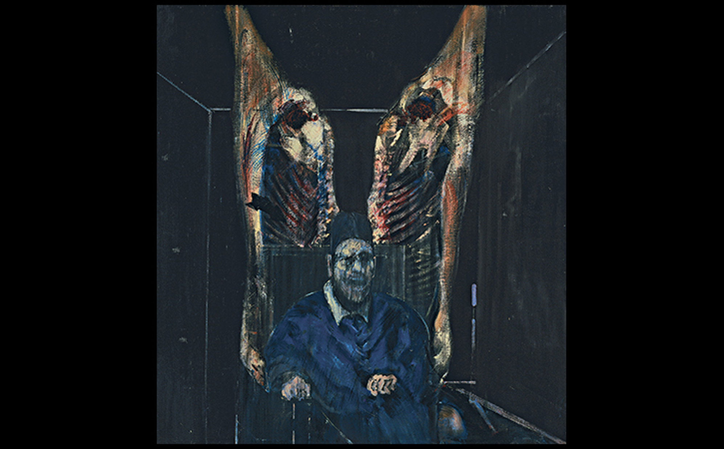
Francis Bacon HEAD SURROUNDED BY SIDES OF BEEF 1954. Oil on canvas, 50-3/4" × 48" (129 × 122 cm). The Art Institute of Chicago. Harriott A. Fox Fund (1956.1201). © The Estate of Francis Bacon. All rights reserved. DACS, London/ARS, NY 2016. Photo © The Art Institute of Chicago.
Notes:
Francis Bacon FIGURE WITH MEAT 1954. Oil on canvas, 50-3/4" × 48" (129 × 122 cm). The Art Institute of Chicago. Harriott A. Fox Fund (1956.1201). © The Estate of Francis Bacon. All rights reserved. DACS, London/ARS, NY 2016. Photo © The Art Institute of Chicago

Slide 71
Figural Responses and Art Informel in Europe (2 of 2)
Art informel (tachisme) was a distinct movement born of the sentiment that art should comprise of simple, honest marks to express postwar humanity.
Wols's Painting represents a disease-ridden and violent world through its semiabstracted form that resembles a cell or bacterial growth.

Slide 72
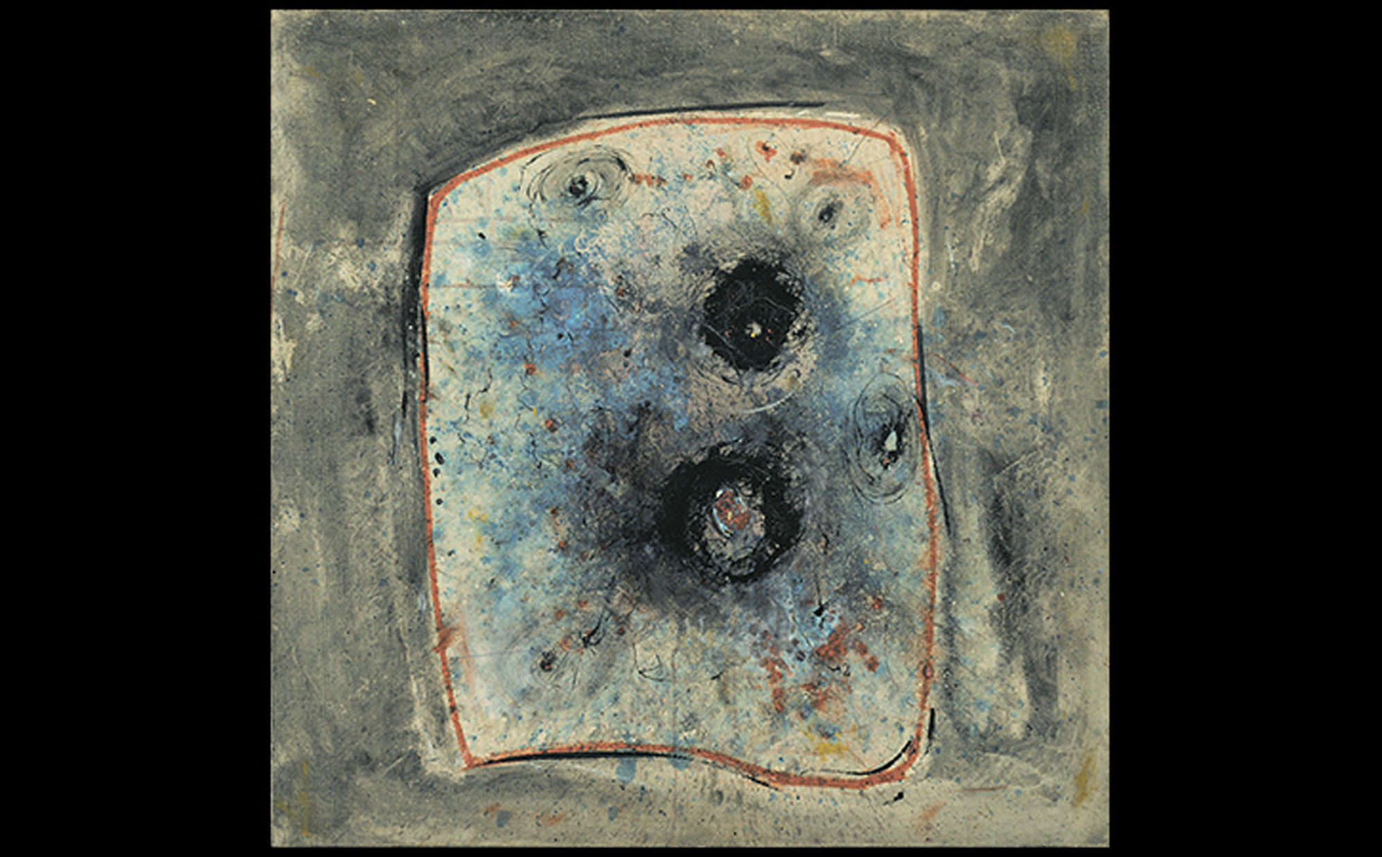
Wols (Wolfgang Schulze) PAINTING 1944–1945. Oil on canvas, 31-7/8" × 32" (81 × 81.1 cm). Museum of Modern Art, New York. Gift of D. and J. de Menil Fund (29.1956). © 2016 Artists Rights Society (ARS), New York/ADAGP, Paris. © 2016. Digital Image, The Museum of Modern Art/Scala, Florence
Notes:
Wols (Wolfgang Schulze) PAINTING 1944–1945. Oil on canvas, 31-7/8" × 32" (81 × 81.1 cm). Museum of Modern Art, New York. Gift of D. and J. de Menil Fund (29.1956). © 2016 Artists Rights Society (ARS), New York/ADAGP, Paris. © 2016. Digital Image, The Museum of Modern Art/Scala, Florence.

Slide 73
Experiments in Latin America
Wifredo Lam brought issues of heritage, identity, and discovery to his art in Cuba.
Zambezia, Zambzia recalls European Modernism but represents a santería ritual.
Torres-García's Abstract Art in Five Tones and Complementaries fuses Inca imagery and mason patterns.

Slide 74
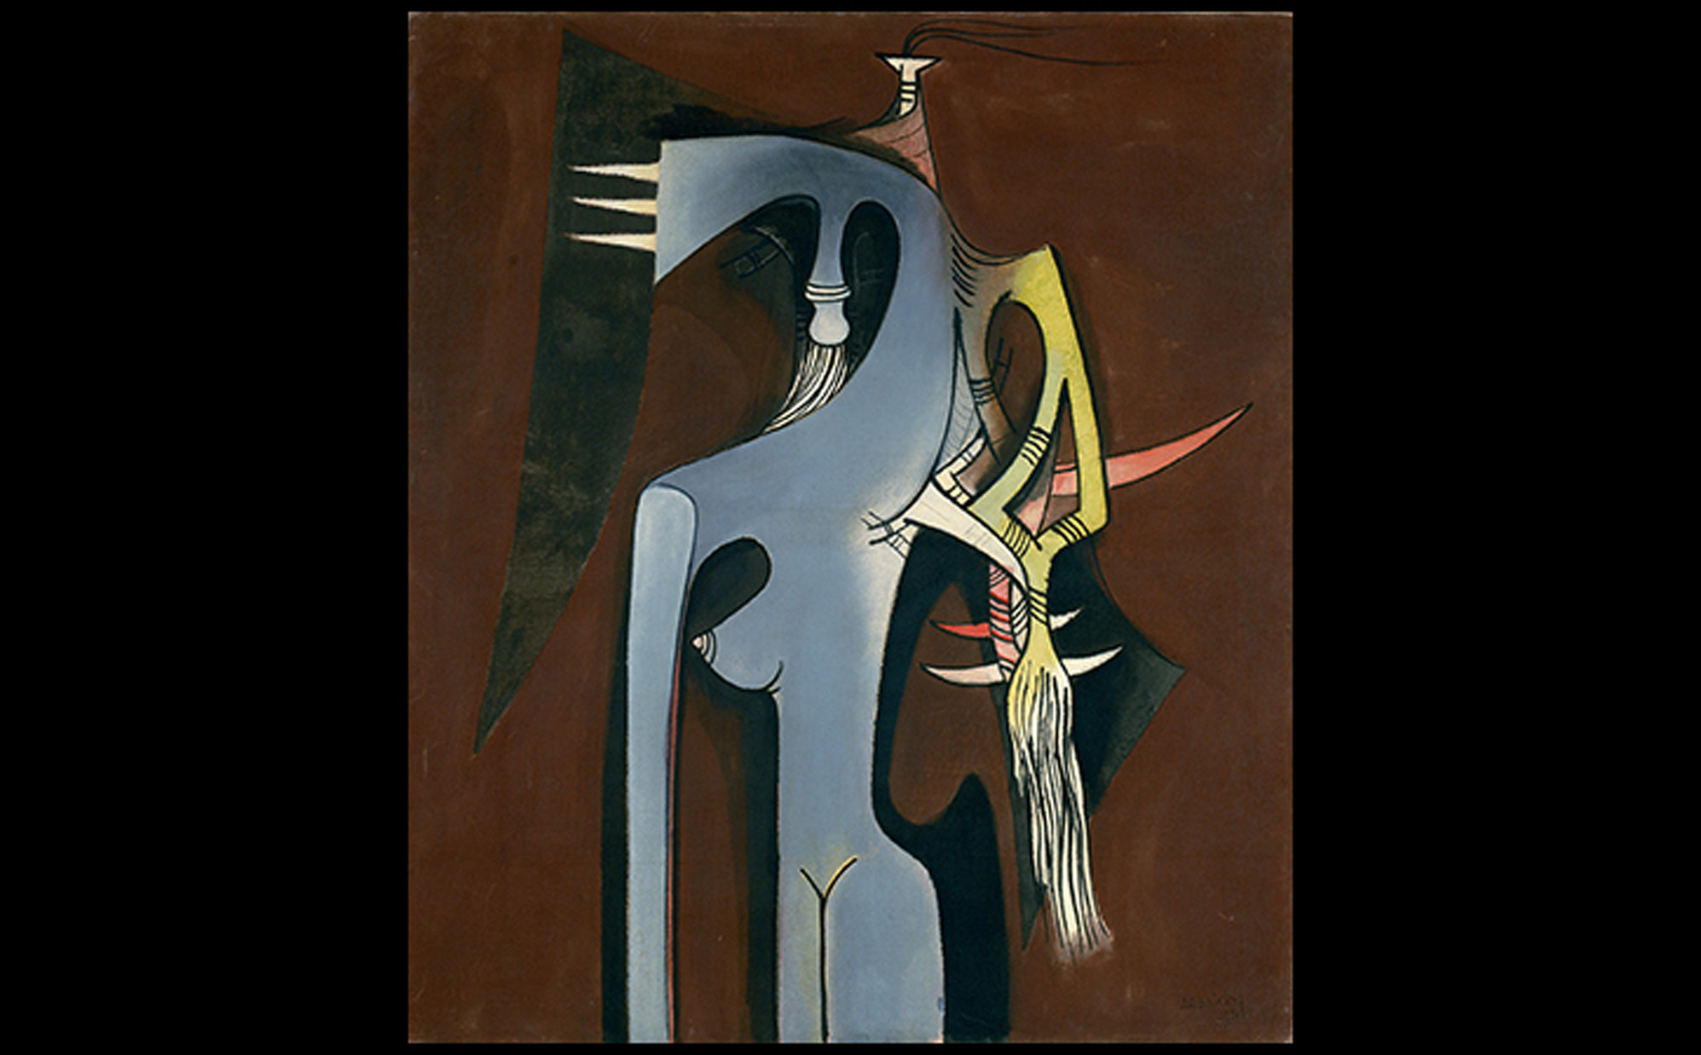
Wifredo Lam ZAMBEZIA, ZAMBEZIA 1950. Oil on canvas, 49-3/8" × 43-5/8" (125 × 110 cm). Solomon R. Guggenheim Museum, New York. Gift, Mr. Joseph Cantor, 1974 (74.2095). © 2016 Artists Rights Society (ARS), New York/ADAGP, Paris. The Solomon R. Guggenheim Foundation/Art Resource, NY.
Notes:
Wifredo Lam ZAMBEZIA, ZAMBEZIA 1950. Oil on canvas, 49-3/8" × 43-5/8" (125 × 110 cm). Solomon R. Guggenheim Museum, New York. Gift, Mr. Joseph Cantor, 1974 (74.2095). © 2016 Artists Rights Society (ARS), New York/ADAGP, Paris. The Solomon R. Guggenheim Foundation/Art Resource, NY.

Slide 75
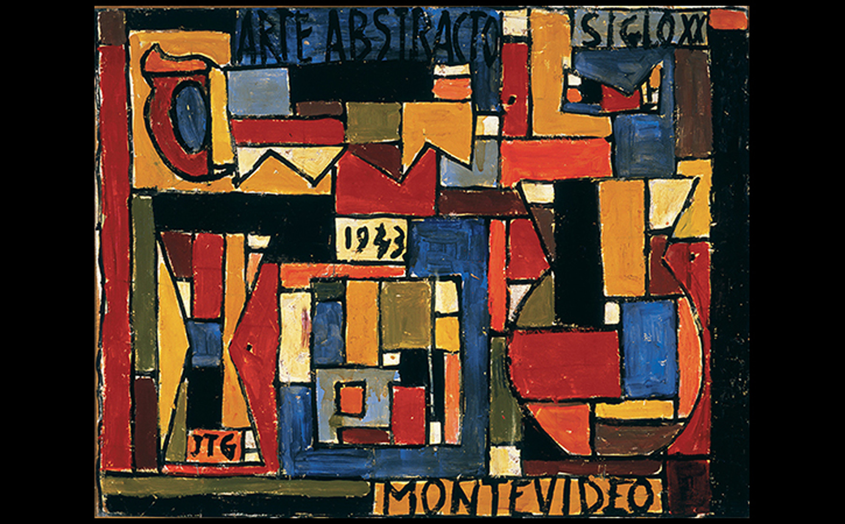
Joaquín Torres-García ABSTRACT ART IN FIVE TONES AND COMPLEMENTARIES 1943. Oil on board mounted on panel, 20-1/2" × 26-5/8" (52.1 × 67 cm). Albright Knox Art Gallery, Buffalo, NY. Gift of Mr. and Mrs. Armand J. Castellani, 1979. Art Resource, NY.
Notes:
Joaquín Torres-García ABSTRACT ART IN FIVE TONES AND COMPLEMENTARIES 1943. Oil on board mounted on panel, 20-1/2" × 26-5/8" (52.1 × 67 cm). Albright Knox Art Gallery, Buffalo, NY. Gift of Mr. and Mrs. Armand J. Castellani, 1979. Art Resource, NY.

